Slide 1
DYSANOS
Generative Smooth Arbitrage-free Non-parametric Option Surfaces
Hans Buehler, joint work with Blanka Horvath, Anastasis Kratsios
University of Oxford, Institute for Mathematics
hans.buehler@maths.ox.ac.uk
International Conference on Computational Finance 2026
London, September 2nd, 2026

Slide 2
Problem Statement
Historic Quantitative Finance Model Development
  Models are solvable – aim is to “calibrate” a model to market.
  Dynamics are an afterthought.
  Local-Vol overlay used to “fit” the market.
  Works well but requires human intervention.
Program:
  Fit a strictly arbitrage free model to historic market data.
  Turn it into a generative option market model.
  Remove the drift to get a risk-neutral model.

Slide 3
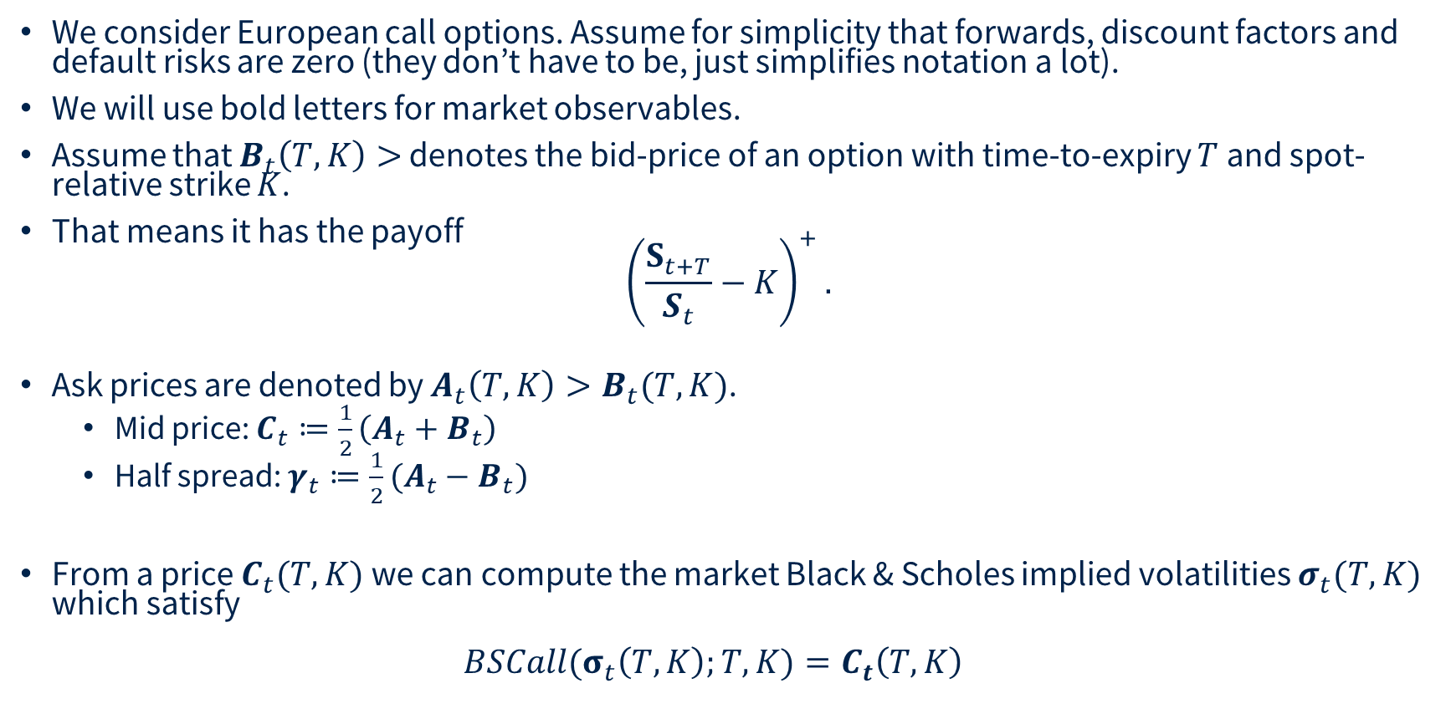
Option Markets
We consider European call options. Assume for simplicity that forwards, discount factors and default risks are zero (they don’t have to be, just simplifies notation a lot).
We will use bold letters for market observables.
Assume that $B_{t}\left(T,K\right)>$ denotes the bid-price of an option with time-to-expiry $T$ and spot-relative strike $K$.
That means it has the payoff
${\left(\frac{S_{t+T}}{S_{t}}−K\right)}^{+}.$
Ask prices are denoted by $A_{t}\left(T,K\right)>B_{t}(T,K)$.
  Mid price: $C_{t}≔\frac{1}{2}\left(A_{t}+B_{t}\right)$
  Half spread: $γ_{t}≔\frac{1}{2}(A_{t}−B_{t})$
From a price $C_{t}(T,K)$ we can compute the market Black & Scholes implied volatilities $σ_{t}(T,K)$ which satisfy
${BSCall(σ}_{t}\left(T,K\right);T,K)=C_{t}\left(T,K\right)$

Slide 4

Option Markets

Slide 5
Option Markets
Problem
  We would like to simulate such markets, ideally under the risk-neutral measure.
Why not use Dupire’s Implied Vol as “code book” directly ?
  No known way to ensure absence of static arbitrage.
  There cannot be a risk-neutral measure if the market is arbitrageable.
  In practice, our method to find such measures blows up numerically.
Parameterizing local vol as “code book” ?
  Resulting call prices are always arbitrage-free
  Continuous time/space “Dupire” too hard to handle:
    Requires arb-free interpolation of real market data so it can be computed
    Pricing “in simulation” on a GPU requires solving forward-PDEs.
  Let us use smoothed discrete local volatility then – SANOS.

Slide 6
SANOS
Smooth Arbitrage-free Non-parametric Option Surfaces
Joint work with Blanka Horvath, Anastasis Kratsios, Yannick Limmer, Raeid Saqur

Slide 7
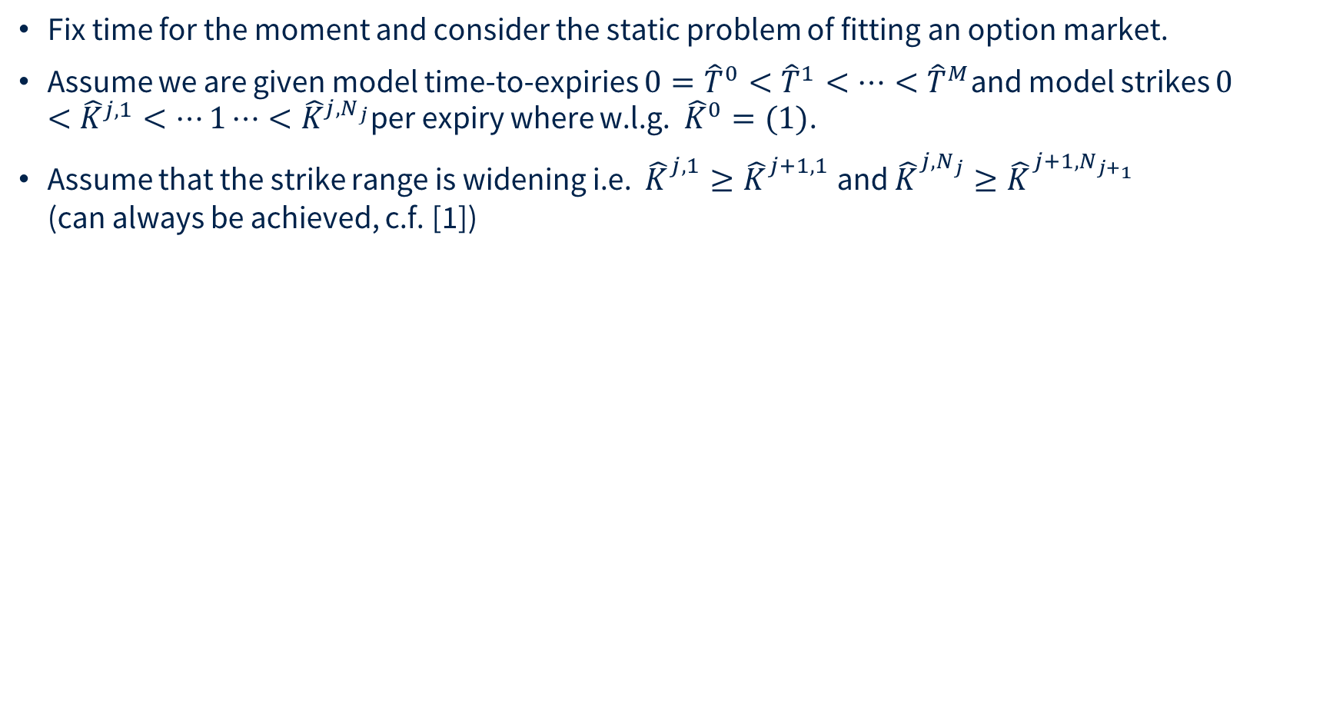
SANOS
Fix time for the moment and consider the static problem of fitting an option market.
Assume we are given model time-to-expiries $0={\hat{T}}^{0}<{\hat{T}}^{1}<⋯<{\hat{T}}^{M}$and model strikes $0<{\hat{K}}^{j,1}<⋯1⋯<{\hat{K}}^{j,N_{j}}$per expiry where w.l.g. ${\hat{K}}^{0}=(1)$.
Assume that the strike range is widening i.e. ${\hat{K}}_{}^{j,1}≥{\hat{K}}_{}^{j+1,1}$ and ${\hat{K}}_{}^{j,N_{j}}≥{\hat{K}}_{}^{{j+1,N}_{j+_{1}}}$
(can always be achieved, c.f. [1])
__
[1] Buehler et al, 2026 SANOS https://arxiv.org/pdf/2601.11209

Slide 8
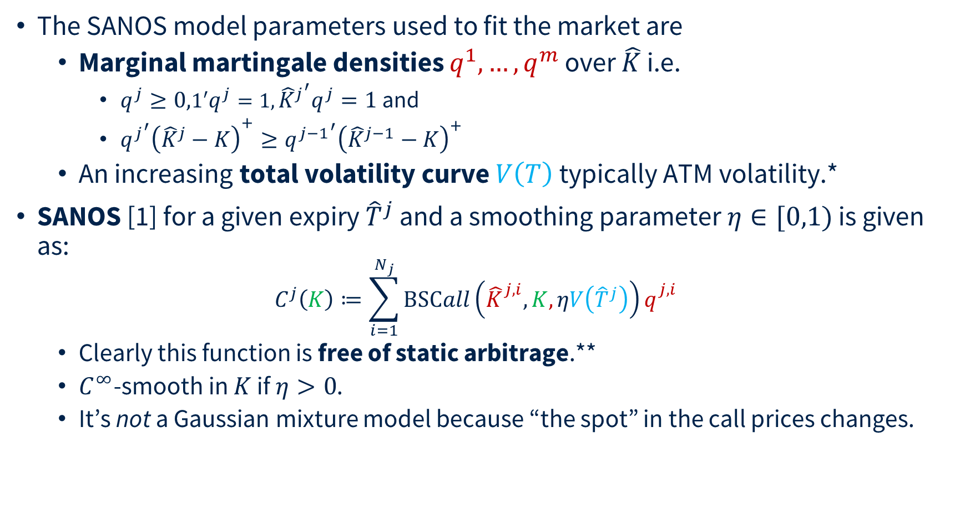
SANOS
The SANOS model parameters used to fit the market are
  Marginal martingale densities $q^{1},…,q^{m}$ over $\hat{K}$ i.e.
    $q^{j}≥0,1′q^{j}=1,{{\hat{K}}^{j}}^{′}q^{j}=1$ and
    ${{q^{j}}^{′}\left({\hat{K}}^{j}−K\right)}^{+}≥{q^{j−1}}^{′}{\left({\hat{K}}^{j−1}−K\right)}^{+}$
  An increasing total volatility curve $V\left(T\right)$ typically ATM volatility.*
SANOS [1] for a given expiry ${\hat{T}}^{j}$ and a smoothing parameter $η∈[0,1)$ is given as:
$C^{j}\left(K\right)≔\sum_{i=1}^{N_{j}}{BSCall\left({\hat{K}}_{}^{j,i},K,ηV\left({\hat{T}}^{j}\right)\right)q_{}^{j,i}}$
  Clearly this function is free of static arbitrage.**
  $C^{∞}$-smooth in $K$ if $η>0$.
  It’s not a Gaussian mixture model because “the spot” in the call prices changes.
__
[1] Buehler et al, 2026 SANOS https://arxiv.org/pdf/2601.11209
* Using volatility instead of variance avoids taking square roots (and therefore derivatives thereof) of a variable which can become zero in torch.
** In the sense of the first fundamental theorem of asset pricing, e.g. existence of an integrable positive variable $Z_{j}$such that $C^{j}\left(K\right)=E\left[{\left(Z_{j}−K\right)}^{+}\right].$

Slide 9
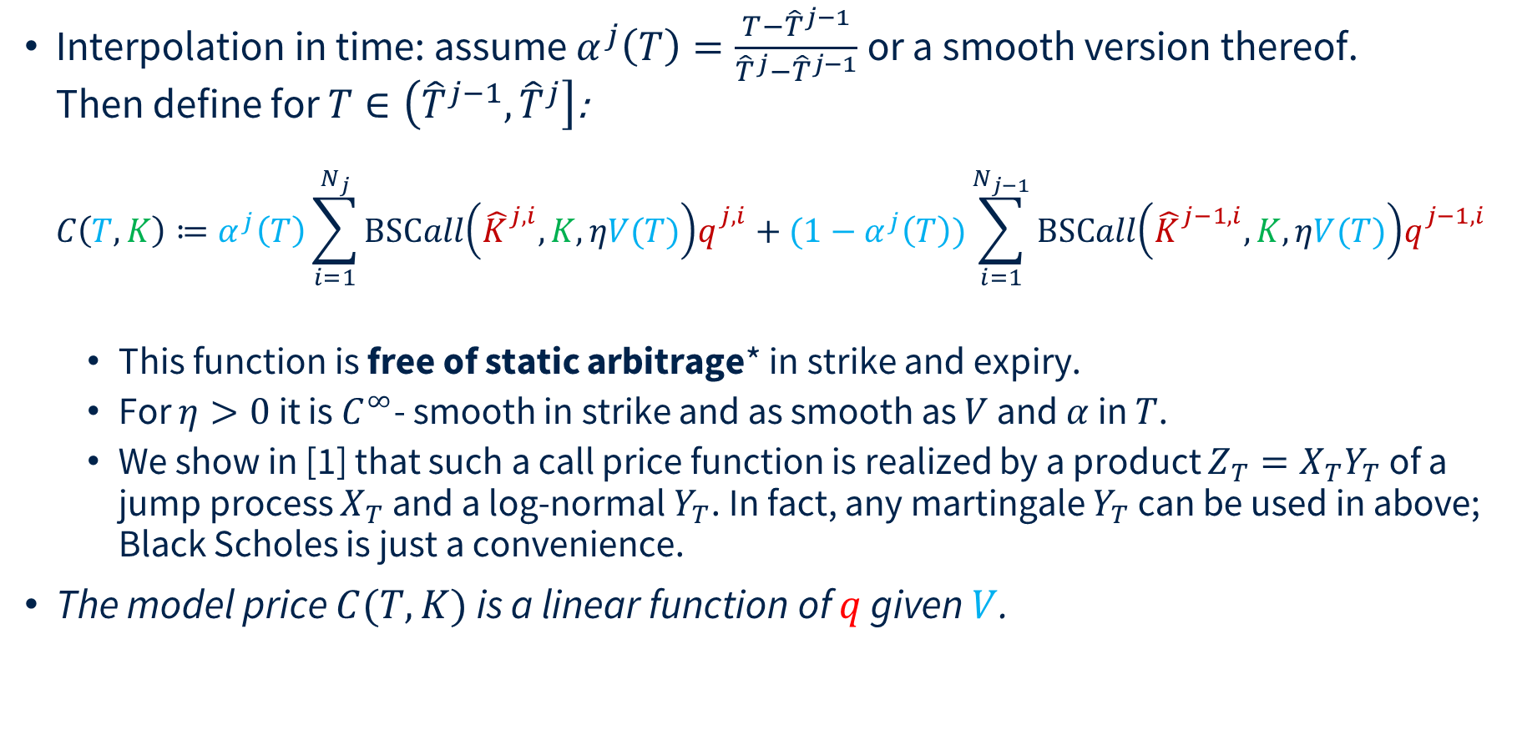
SANOS
Interpolation in time: assume $α^{j}\left(T\right)=\frac{T−{\hat{T}}^{j−1}}{{\hat{T}}^{j}−{\hat{T}}^{j−1}}$ or a smooth version thereof.
Then define for $T∈\left({\hat{T}}^{j−1},{\hat{T}}^{j}\right]$:
$C\left(T,K\right)≔α^{j}\left(T\right)\sum_{i=1}^{N_{j}}{BSCall\left({\hat{K}}_{}^{j,i},K,ηV(T)\right)q_{}^{j,i}}+(1−α^{j}\left(T\right))\sum_{i=1}^{N_{j−1}}{BSCall\left({\hat{K}}_{}^{j−1,i},K,ηV(T)\right)q_{}^{j−1,i}}$
  This function is free of static arbitrage* in strike and expiry.
  For $η>0$ it is $C^{∞}$- smooth in strike and as smooth as $V$ and $α$ in $T$.
  We show in [1] that such a call price function is realized by a product ${Z_{T}=X}_{T}Y_{T}$ of a jump process $X_{T}$ and a log-normal $Y_{T}$. In fact, any martingale $Y_{T}$ can be used in above; Black Scholes is just a convenience.
The model price $C(T,K)$ is a linear function of $q$ given $V$.
__
[1] Buehler et al, 2026 SANOS https://arxiv.org/pdf/2601.11209
* i.e. first fundamental theorem of asset pricing: existence of an integrable positive martingale $Z_{T}$such that $C\left(T,K\right)=E\left[{\left(Z_{T}−K\right)}^{+}\right].$

Slide 10

Fitting to the Market
For the $ℓ$^{th} market option the price $C^{ℓ}≔C(T^{ℓ},K^{ℓ})$ is a linear function of $q$.
Then [1] we may find an arbitrage-free smooth interpolation of discrete call prices $C_{j}^{i}$ jointly across all strikes and expiries by solving a linear problem
$\min_{q}{:}\sum_{ℓ }{\frac{1}{γ_{ℓ}^{i}}\left\{{\left(C_{}^{ℓ}−A_{}^{ℓ}\right)}^{+}+{\left(B_{}^{ℓ}−C_{}^{ℓ}\right)}^{+}+ε \left|C_{}^{ℓ}−M_{}^{ℓ}\right|\right\}}$
with linear constraints:
  $q_{j}≥0$, $1^{′}q^{j}=1$,${{\hat{K}}^{j}}^{′}q^{j}=1$
  ${q^{j}′\left({\hat{K}}^{j}−{\hat{K}}_{}^{j,i}\right)}^{+}≥{q^{j−1}}^{′}{\left({\hat{K}}^{j−1}−{\hat{K}}_{}^{j,i}\right)}^{+}$for all $i,j$.
Straightforward global fit with linear programming.
__
[1] Buehler et al, 2026 SANOS https://arxiv.org/pdf/2601.11209

Slide 11
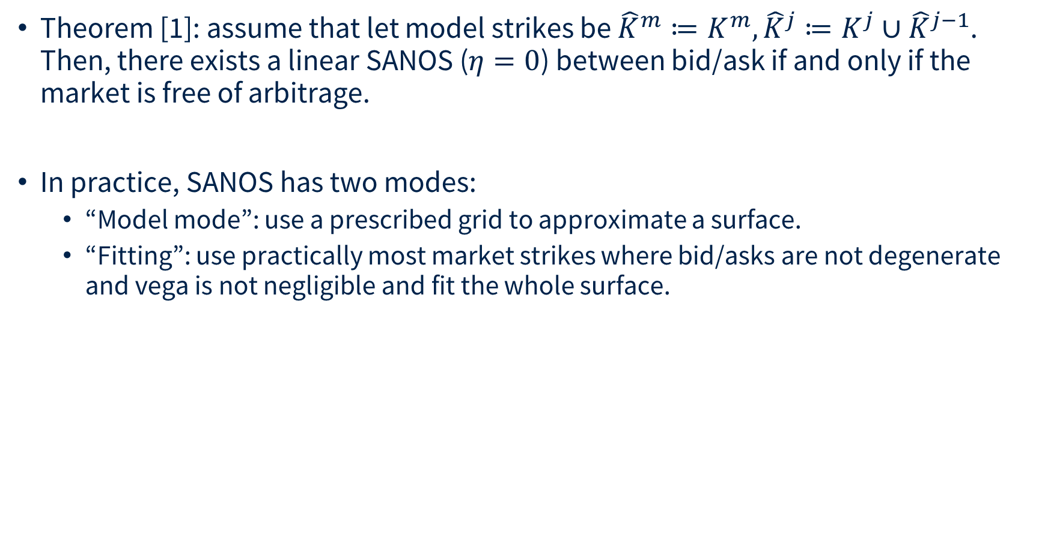
SANOS
Theorem [1]: assume that let model strikes be ${\hat{K}}^{m}≔K^{m},{\hat{K}}^{j}≔K^{j}∪{\hat{K}}^{j−1}$.
Then, there exists a linear SANOS ($η=0$) between bid/ask if and only if the market is free of arbitrage.
In practice, SANOS has two modes:
  “Model mode”: use a prescribed grid to approximate a surface.
  “Fitting”: use practically most market strikes where bid/asks are not degenerate and vega is not negligible and fit the whole surface.
__
[1] Buehler et al, 2026 SANOS https://arxiv.org/pdf/2601.11209
* i.e. first fundamental theorem of asset pricing: existence of an integrable positive martingale $Z_{T}$such that $C\left(T,K\right)=E\left[{\left(Z_{T}−K\right)}^{+}\right].$

Slide 12


Fitting to the Market
Fitted 1000 options within 2 ATM implied volatility standard deviations which had a Vega/sqrtT of at least 0.1% on 2025-05-06 across all 48 expiries from 1D to 657 business days.
Options were chosen by closeness to ATM. The model fitted 91.4% of all options within bid/ask. Of those options not fitted the median error is just 21% of half spread.
The fit took sub-seconds on a desktop PC.

Slide 13
DYSANOS
Generative Smooth Arbitrage-free Non-parametric Option Surfaces [1]
__
[1] Hans Buehler et al. DYSANOS Generative Dynamic Smooth Arbitrage-free Non-parametric Option Surfaces, 2026 https://arxiv.org/abs/2608.12587

Slide 14
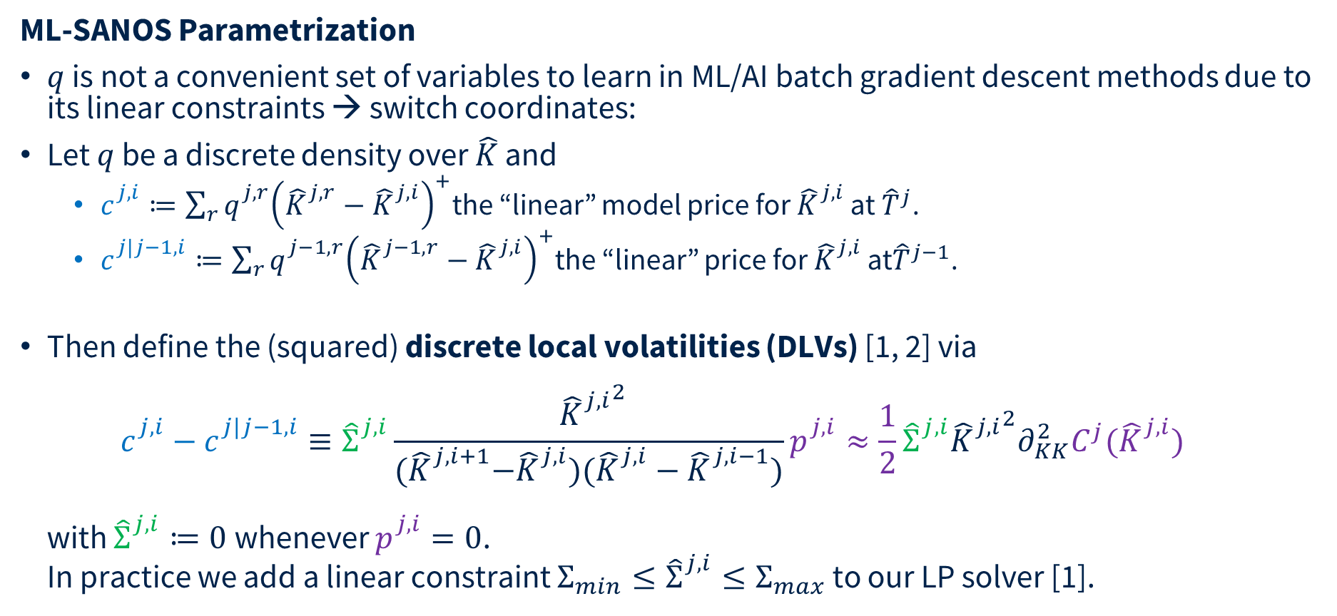
DYSANOS
ML-SANOS Parametrization
$q$ is not a convenient set of variables to learn in ML/AI batch gradient descent methods due to its linear constraints → switch coordinates:
Let $q$ be a discrete density over $\hat{K}$ and
  $c_{}^{j,i}≔\sum_{r}{q_{}^{j,r}{\left({\hat{K}}_{}^{j,r}−{\hat{K}}_{}^{j,i}\right)}^{+}}$the “linear” model price for ${\hat{K}}_{}^{j,i}$ at ${\hat{T}}^{j}$.
  $c_{}^{j|j−1,i}≔\sum_{r}{q_{}^{j−1,r}{\left({\hat{K}}_{}^{j−1,r}−{\hat{K}}_{}^{j,i}\right)}^{+}}$the “linear” price for ${\hat{K}}_{}^{j,i}$ at${\hat{T}}^{j−1}$.
Then define the (squared) discrete local volatilities (DLVs) [1, 2] via
$c_{}^{j,i}−c_{}^{j|j−1,i}≡{\hat{Σ}}_{}^{j,i}\frac{ {{\hat{K}}_{}^{j,i}}^{2}}{{(\hat{K}}_{}^{j,i+1}−{\hat{K}}_{}^{j,i})({\hat{K}}_{}^{j,i}−{\hat{K}}_{}^{j,i−1})}p_{}^{j,i}≈\frac{1}{2}{\hat{Σ}}_{}^{j,i}{{\hat{K}}_{}^{j,i}}^{2}∂_{KK}^{2}C^{j}({\hat{K}}_{}^{j,i})$
with ${\hat{Σ}}_{}^{j,i}≔0$ whenever $p_{}^{j,i}=0$.
In practice we add a linear constraint ${Σ_{min}≤\hat{Σ}}_{}^{j,i}≤Σ_{max}$ to our LP solver [1].
__
[1] Hans Buehler and Evgeny Ryskin. Discrete local volatility for large time steps (extended version). https://papers.ssrn.com/abstract=2642630 2015.
[2] Finite Difference Based Calibration and Simulation Andreasen et al, 2010 https://papers.ssrn.com/sol3/papers.cfm?abstract_id=1697545

Slide 15
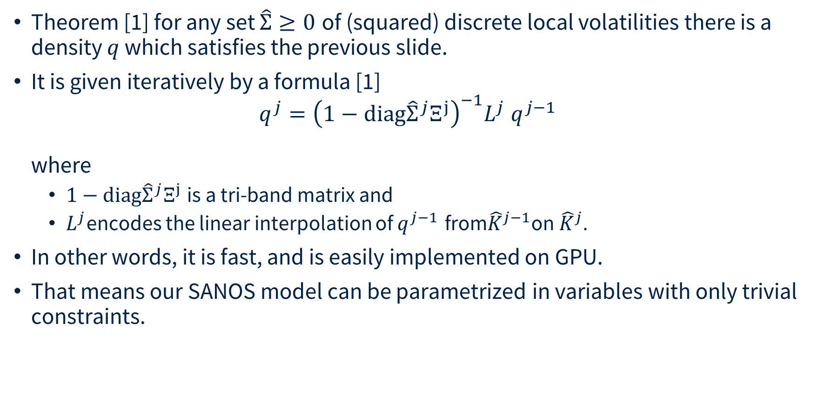
DYSANOS
Theorem [1] for any set $\hat{Σ}≥0$ of (squared) discrete local volatilities there is a density $q$ which satisfies the previous slide.
It is given iteratively by a formula [1]
$q^{j}={\left(1−\text{diag}{\hat{Σ}}^{j}Ξ^{j}\right)}^{−1}L^{j} q^{j−1}$
where
  $1−\text{diag}{\hat{Σ}}^{j}Ξ^{j}$is a tri-band matrix and
  $L^{j}$encodes the linear interpolation of $q^{j−1}$ from${\hat{K}}^{j−1}$on${ \hat{K}}^{j}$.
In other words, it is fast, and is easily implemented on GPU.
That means our SANOS model can be parametrized in variables with only trivial constraints.
__
[1] Hans Buehler and Evgeny Ryskin. Discrete local volatility for large time steps (extended version). https://papers.ssrn.com/abstract=2642630 2015.

Slide 16
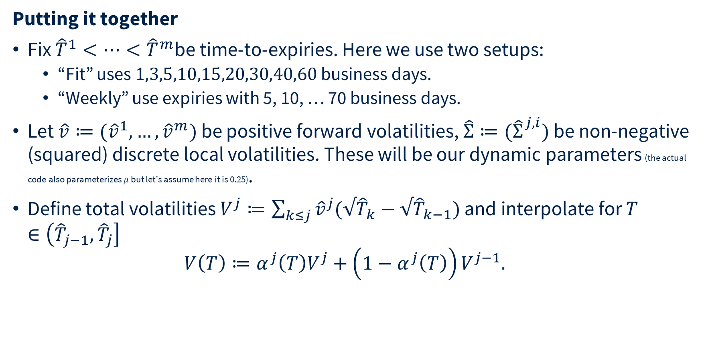
DYSANOS
Putting it together
Fix ${\hat{T}}^{1}<⋯<{\hat{T}}^{m}$be time-to-expiries. Here we use two setups:
  “Fit” uses $1,3,5,10,15,20,30,40,60$ business days.
  “Weekly” use expiries with 5, 10, … 70 business days.
Let $\hat{v}≔({\hat{v}}^{1},…,{\hat{v}}^{m})$ be positive forward volatilities, ${\hat{Σ}≔(\hat{Σ}}_{}^{j,i})$ be non-negative (squared) discrete local volatilities. These will be our dynamic parameters (the actual code also parameterizes $μ$ but let’s assume here it is 0.25).
Define total volatilities $V^{j}≔\sum_{k≤j}{{\hat{v}}^{j}(√{\hat{T}}_{k}−{√\hat{T}}_{k−1})}$ and interpolate for $T∈\left({\hat{T}}_{j−1},{\hat{T}}_{j}\right]$
$V\left(T\right)≔α^{j}\left(T\right)V^{j}+\left(1−α^{j}\left(T\right)\right)V^{j−1}.$

Slide 17
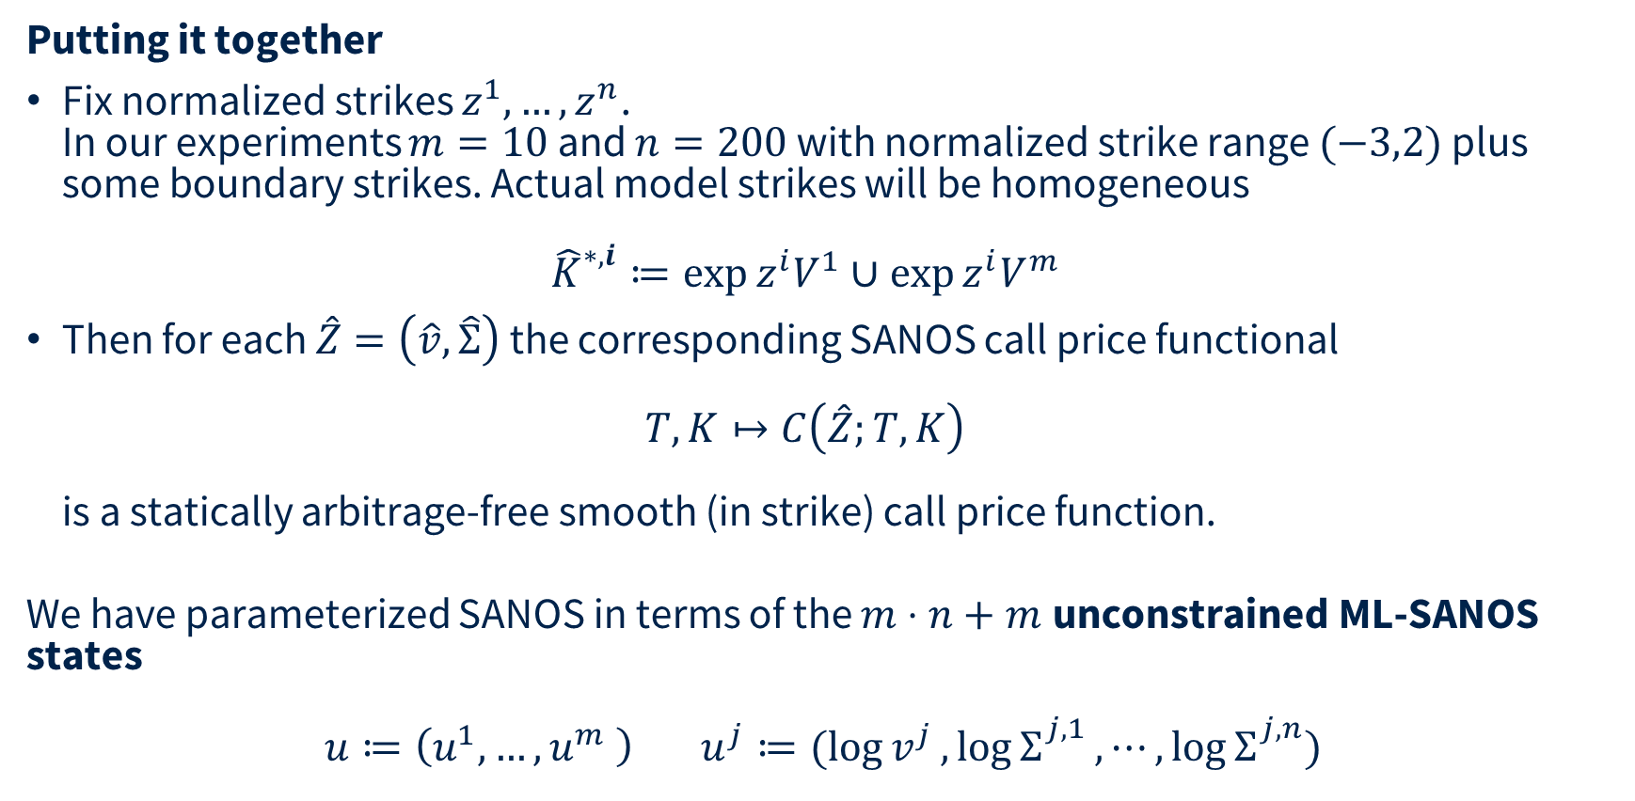
DYSANOS
Putting it together
Fix normalized strikes $z^{1},…,z^{n}$.
In our experiments $m=10$ and $n=200$ with normalized strike range $(−3,2)$ plus some boundary strikes. Actual model strikes will be homogeneous
${\hat{K}}_{}^{∗,i}≔\exp{z^{i}V^{1}}∪\exp{z^{i}V^{m}}$
Then for each $\hat{Z}=\left(\hat{v},\hat{Σ}\right)$ the corresponding SANOS call price functional
$T,K↦C\left(\hat{Z};T,K\right)$
is a statically arbitrage-free smooth (in strike) call price function.
We have parameterized SANOS in terms of the $m⋅n+m$unconstrained ML-SANOS states
$$u≔\left(u^{1},…,u^{m} \right) u^{j}≔(\log{v^{j}},\log{Σ_{}^{j,1}},⋯,\log{Σ_{}^{j,n}})$$

Slide 18
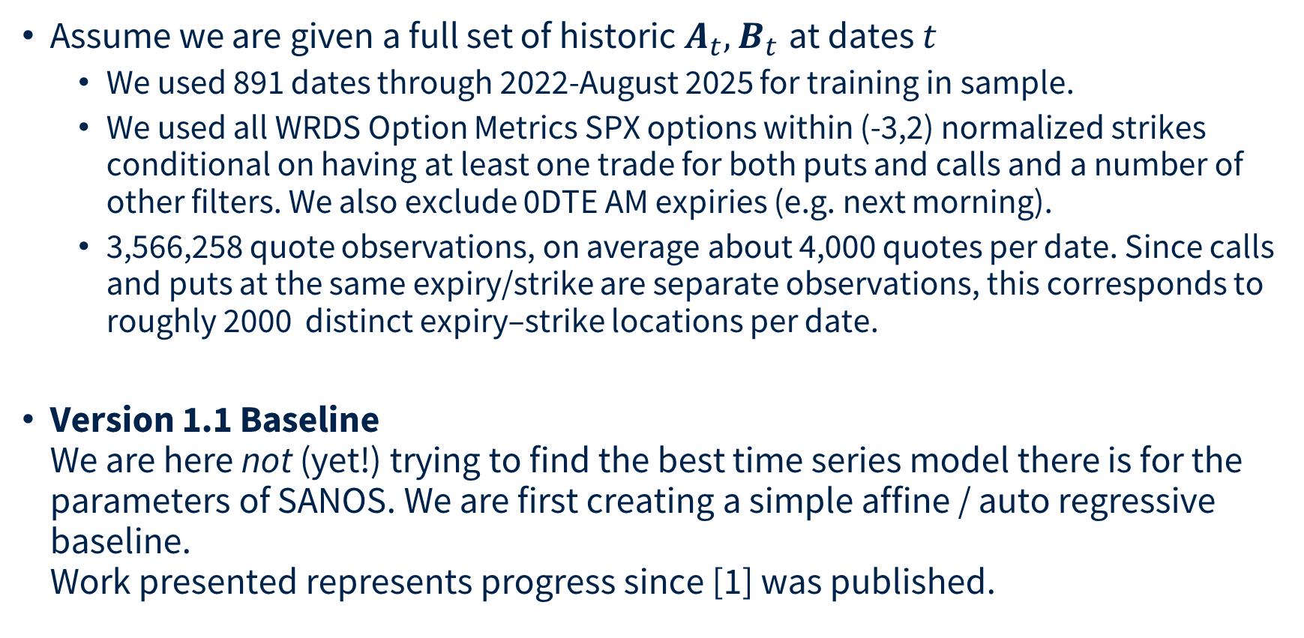
Linear Auto Regressive DYSANOS
REVIEW: 200 affine state coordinates are not the IV PCs shown later.
Assume we are given a full set of historic $A_{t},B_{t}$ at dates $t$
  We used 891 dates through 2022-August 2025 for training in sample.
  We used all WRDS Option Metrics SPX options within (-3,2) normalized strikes conditional on having at least one trade for both puts and calls and a number of other filters. We also exclude 0DTE AM expiries (e.g. next morning).
  3,566,258 quote observations, on average about 4,000 quotes per date. Since calls and puts at the same expiry/strike are separate observations, this corresponds to roughly 2000 distinct expiry–strike locations per date.
Version 1.1 Baseline
We are here not (yet!) trying to find the best time series model there is for the parameters of SANOS. We are first creating a simple affine / auto regressive baseline.
Work presented represents progress since [1] was published.
__
[1] Hans Buehler et al. DYSANOS Generative Dynamic Smooth Arbitrage-free Non-parametric Option Surfaces, 2026 https://arxiv.org/abs/2608.12587

Slide 19
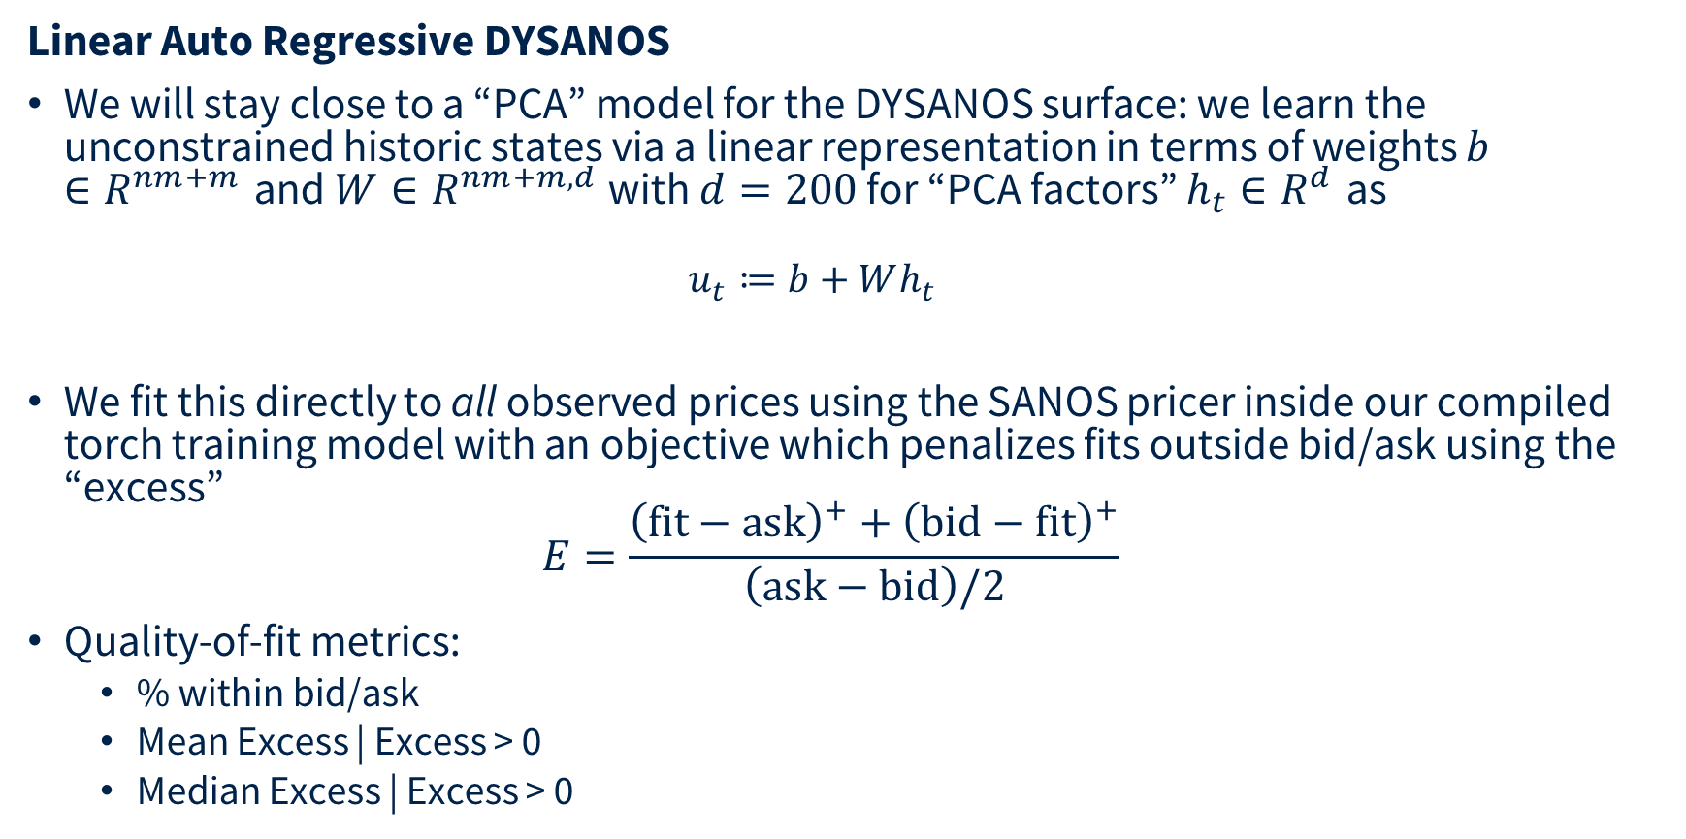
Linear Auto Regressive DYSANOS
REVIEW: Weekly transition step and expiry-node grid are distinct choices.
Linear Auto Regressive DYSANOS
We will stay close to a “PCA” model for the DYSANOS surface: we learn the unconstrained historic states via a linear representation in terms of weights $b∈R^{nm+m}$ and $W∈R^{nm+m,d}$ with $d=200$ for “PCA factors” $h_{t}∈R^{d}$ as
  $$u_{t}≔b+Wh_{t}$$
We fit this directly to all observed prices using the SANOS pricer inside our compiled torch training model with an objective which penalizes fits outside bid/ask using the “excess”
$E=\frac{{\left(\text{fit}−\text{ask}\right)}^{+}+{\left(\text{bid}−\text{fit}\right)}^{+}}{\left(\text{ask}−\text{bid}\right)/2}$
Quality-of-fit metrics:
  % within bid/ask
  Mean Excess | Excess > 0
  Median Excess | Excess > 0

Slide 20
Linear Auto Regressive DYSANOS
Weekly Model
First column: we compare the fit to the full market vs plain SANOS for the same model geometry. We get essentially the same result.
Second column: the model does not fit well for market expiries before the first model expiry.
Statistic | Market ≤ Last Model Expiry | First Model ≤ Market ≤ Last Model Expiry
# quotes | 3,569,180 | 3,125,368
% inside bid–ask | 73% / 73%* | 78%
Mean conditional excess | 3.86 / 3.99* | 2.1723
Median conditional excess | 1.33 / 1.35* | 0.9097
__

Slide 21
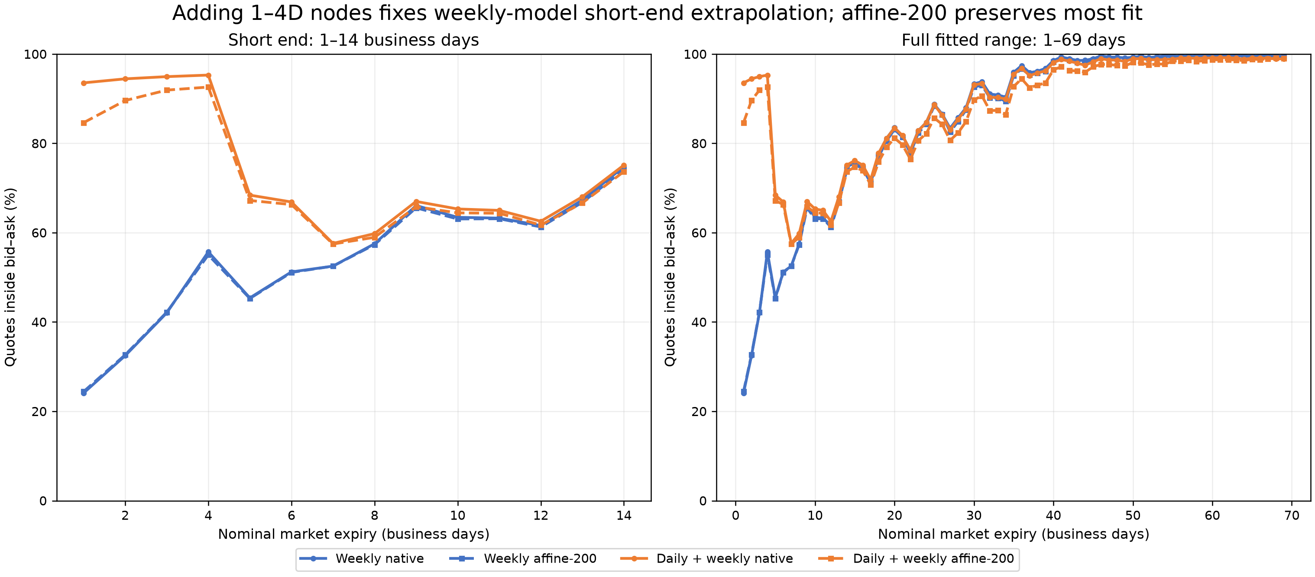
Short-end expiry nodes fix the weekly model's extrapolation
REPLACES 20
Model | Quote books | Inside bid–ask | Mean excess | Cond. mean | Cond. median
Weekly native | 3,566,742 | 73.29% | 1.109 | 4.152 | 1.424
Weekly affine-200 | 3,566,742 | 72.97% | 1.100 | 4.069 | 1.398
Daily + weekly native | 3,566,258 | 81.84% | 0.316 | 1.739 | 0.689
Daily + weekly affine-200 | 3,566,258 | 80.01% | 0.332 | 1.661 | 0.681
891 dates, 2022–Aug 2025; 0.2D AM contracts excluded; all nominal market expiries 1–69D. Excess is measured in half-spreads.

Slide 22
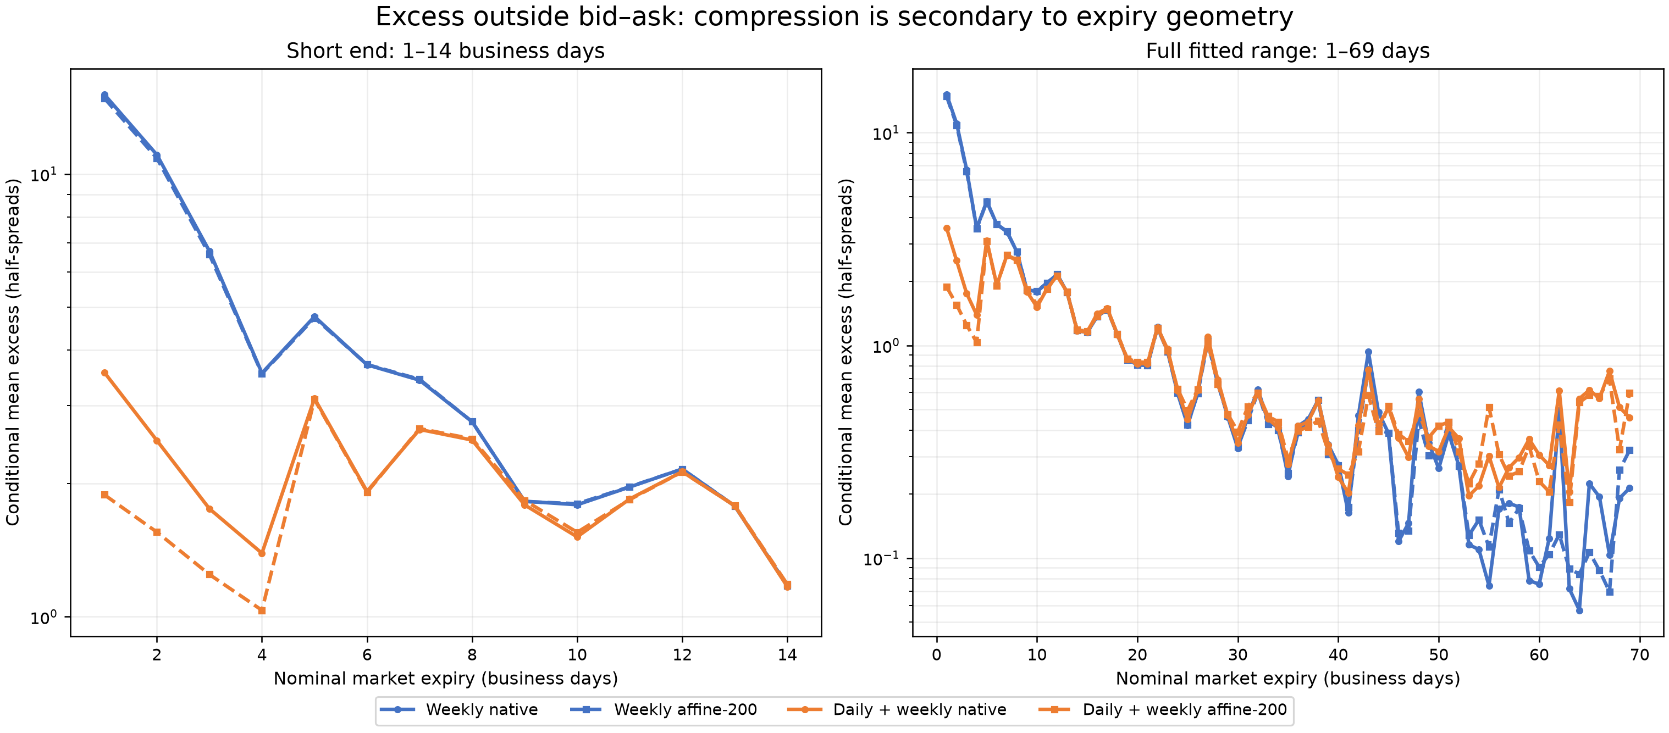
Compression is not the fit bottleneck; expiry geometry is
REVIEW — NEW
Weekly affine-200: −0.32 pp inside bid–ask versus native. Daily+weekly affine-200: −1.83 pp. The dominant gain is from explicit 1–4D expiry nodes, not additional state dimension.
The plot includes every nominal expiry bucket; exact per-expiry CSV tables were retained with the analysis output.

Slide 23

Generative SANOS
Example fit (between model expiries)

Slide 24
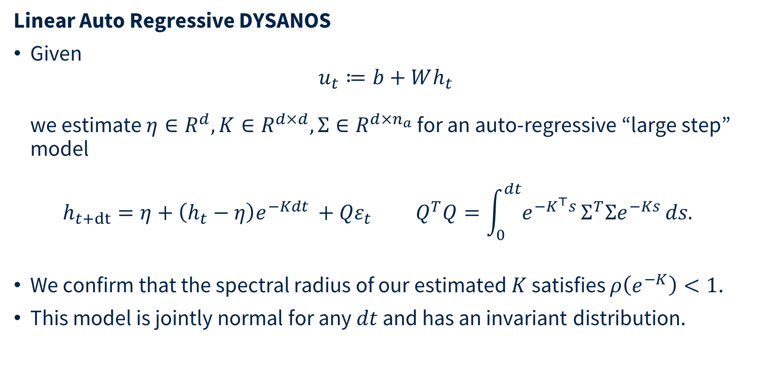
Linear Auto Regressive DYSANOS
Linear Auto Regressive DYSANOS
Given
$u_{t}≔b+Wh_{t}$
we estimate $η∈R^{d}, K∈R^{d×d},Σ∈R^{d×n_{a}}$ for an auto-regressive “large step” model
$h_{t+dt}=η+\left(h_{t}−η\right)e^{−Kdt }+{Qε}_{t} Q^{T}Q=\int_{0}^{dt}{e^{−K^{⊤}s}}Σ^{T}Σe^{−Ks} ds.$
We confirm that the spectral radius of our estimated $K$ satisfies $ρ\left(e^{−K}\right)<1$.
This model is jointly normal for any $dt$ and has an invariant distribution.

Slide 25
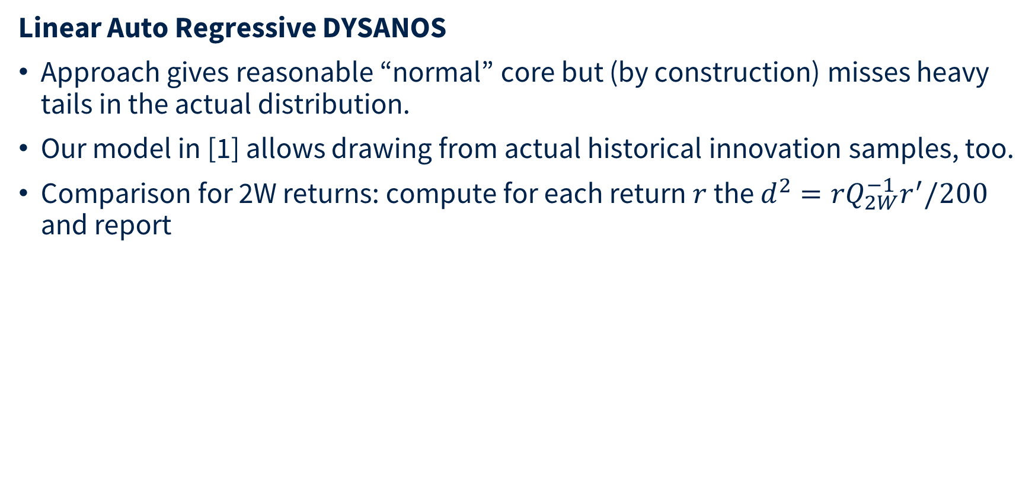
Linear Auto Regressive DYSANOS
REVIEW: Hidden: replaced by stable-AR diagnostics and explicit market/normal/resampling comparisons.
Linear Auto Regressive DYSANOS
Approach gives reasonable “normal” core but (by construction) misses heavy tails in the actual distribution.
Our model in [1] allows drawing from actual historical innovation samples, too.
Comparison for 2W returns: compute for each return $r$ the $d^{2}=rQ_{2W}^{−1}r^{′}/200$ and report
 | Returns | RMSE | Mean | Median | q95 | q99 | Above Market q95 | Above Market q99
Market | 857 | 0.953 | 0.921 | 0.865 | 1.488 | 2.008 | 5.02% | 1.05%
Sampling Mode | 1,000,000 | 0.965 | 0.927 | 0.883 | 1.378 | 1.689 | 2.70% | 0.476%
Normal Mode | analytic | 0.996 | 1.000 | 0.997 | 1.170 | 1.247 | 0.001% | 0%

Slide 26
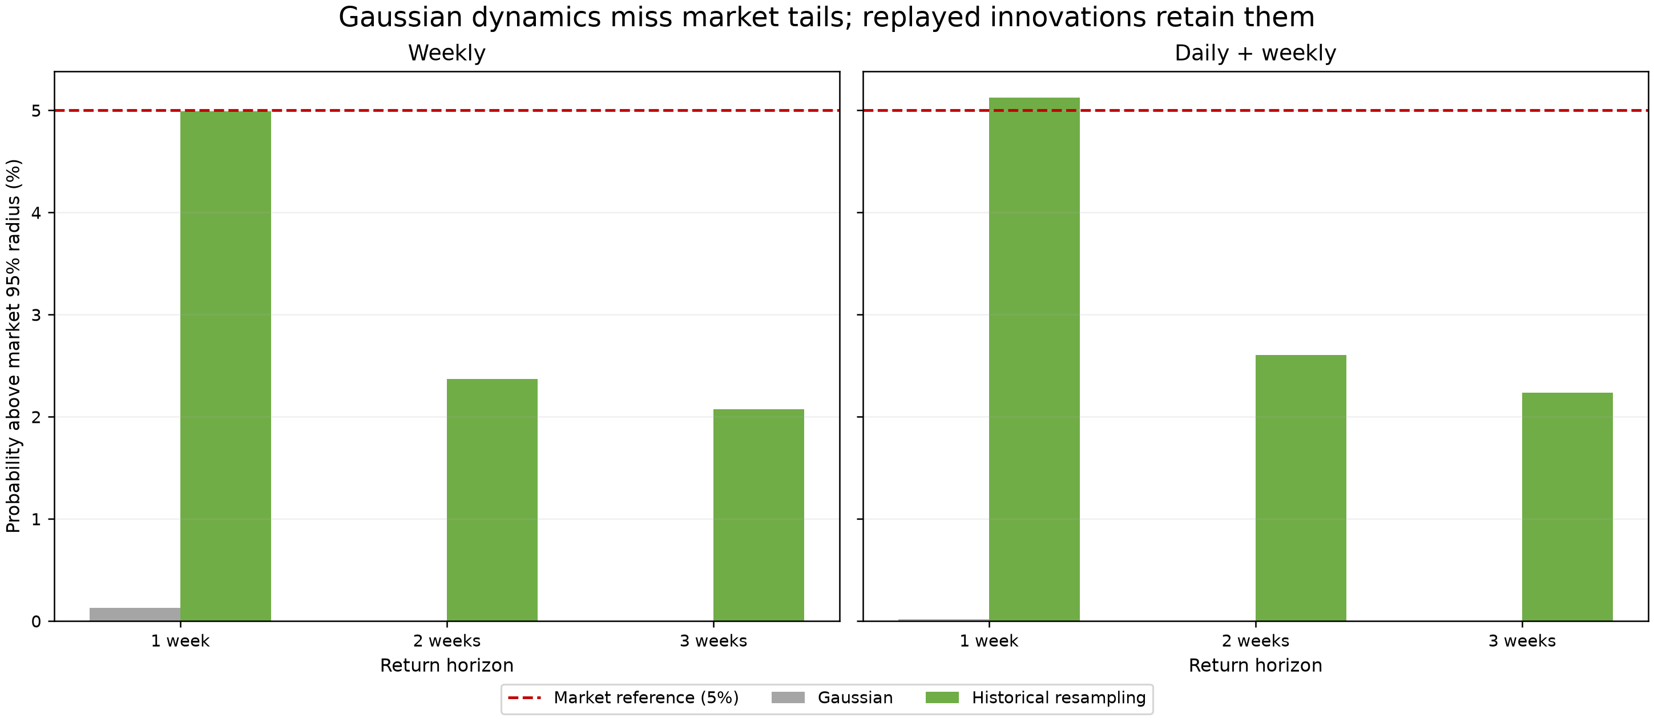
The fitted AR(1) is stable, but Gaussian innovations are too thin-tailed
REPLACES 23
Model | ρ(A) | Slowest half-life | min Re eig(K) | Cov. cond. | Eff. rank
Weekly | 0.9597 | 16.9 weeks | 0.0411 | 3.41 | 193.7/200
Daily + weekly | 0.9535 | 14.6 weeks | 0.0476 | 3.80 | 193.7/200
Interpretation: empirical replay is exact by construction at 1W; its 2W/3W behavior is an independent convolution test.
d²/d = r Q⁻¹ rᵀ / 200. Gaussian values are analytic; resampling uses 1,000,000 independent draws. Market quantiles define exceedance thresholds.

Slide 27
Weekly model: market vs normal vs resampling
REVIEW — NEW
Horizon | Mode | RMS radius | Median d²/d | q95 | q99 | > market q95 | > market q99
1W | Market | 0.941 | 0.842 | 1.328 | 1.939 | 4.99% | 1.05%
1W | Normal | 1.000 | 0.997 | 1.170 | 1.247 | 0.131% | 3.96e-12%
1W | Resample | 0.941 | 0.843 | 1.328 | 1.951 | 4.99% | 1.05%
2W | Market | 0.946 | 0.830 | 1.487 | 2.145 | 5.02% | 1.05%
2W | Normal | 1.000 | 0.997 | 1.170 | 1.247 | 0.000944% | 8.83e-17%
2W | Resample | 0.941 | 0.844 | 1.301 | 1.812 | 2.37% | 0.407%
3W | Market | 0.941 | 0.812 | 1.501 | 2.224 | 5.05% | 1.06%
3W | Normal | 1.000 | 0.997 | 1.170 | 1.247 | 0.000573% | 1.18e-18%
3W | Resample | 0.940 | 0.845 | 1.292 | 1.792 | 2.08% | 0.304%
Market rows use observed exact-horizon state returns. Normal is analytic χ²(200). Resample independently draws empirical 1W innovations and propagates the fitted AR transition.
All data are in-sample; 891 dates. The 1W resample reproduces the empirical innovation distribution mechanically; 2W and 3W are out-of-block convolution checks.

Slide 28
Daily + weekly model: market vs normal vs resampling
REVIEW — NEW
Horizon | Mode | RMS radius | Median d²/d | q95 | q99 | > market q95 | > market q99
1W | Market | 0.942 | 0.821 | 1.394 | 1.989 | 4.99% | 1.05%
1W | Normal | 1.000 | 0.997 | 1.170 | 1.247 | 0.0193% | 3.15e-13%
1W | Resample | 0.942 | 0.821 | 1.396 | 2.033 | 5.13% | 1.04%
2W | Market | 0.950 | 0.810 | 1.569 | 2.495 | 5.02% | 1.05%
2W | Normal | 1.000 | 0.997 | 1.170 | 1.247 | 4.75e-05% | 1.61e-25%
2W | Resample | 0.941 | 0.829 | 1.357 | 1.919 | 2.61% | 0.0106%
3W | Market | 0.945 | 0.798 | 1.605 | 2.458 | 5.05% | 1.06%
3W | Normal | 1.000 | 0.997 | 1.170 | 1.247 | 1.17e-05% | 1.51e-24%
3W | Resample | 0.941 | 0.831 | 1.347 | 1.891 | 2.24% | 0.0089%
Market rows use observed exact-horizon state returns. Normal is analytic χ²(200). Resample independently draws empirical 1W innovations and propagates the fitted AR transition.
All data are in-sample; 891 dates. The 1W resample reproduces the empirical innovation distribution mechanically; 2W and 3W are out-of-block convolution checks.

Slide 29
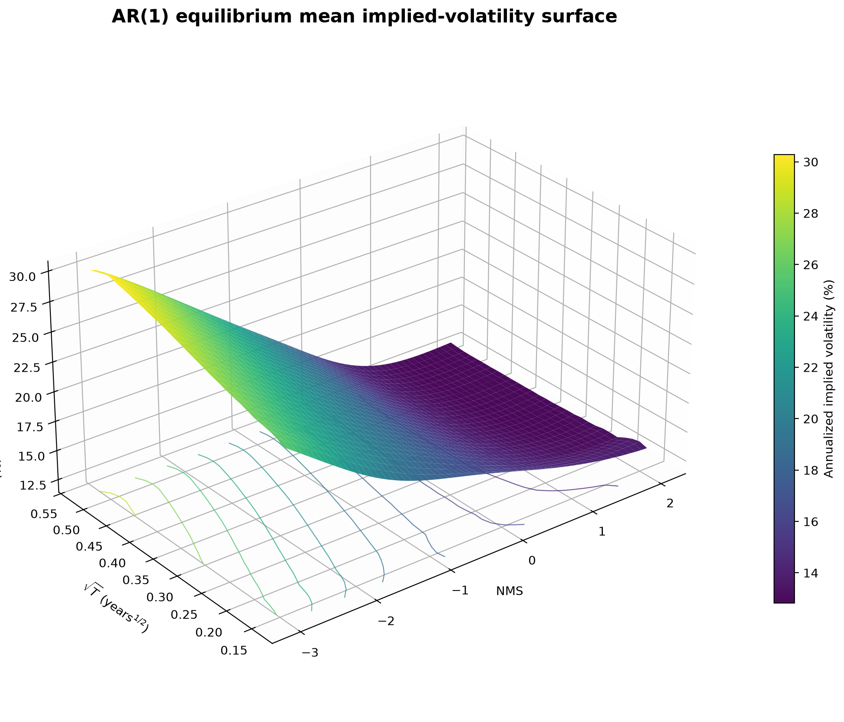
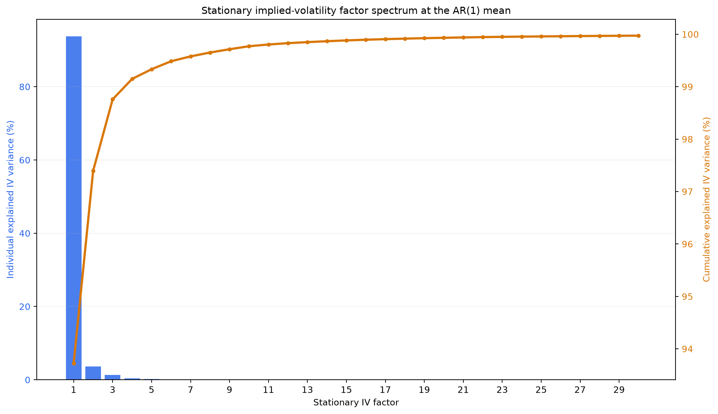
Linear Auto Regressive DYSANOS
REVIEW: Hidden: replaced by comparable IV-space PCA spectra and factor surfaces for both geometries.

Slide 30
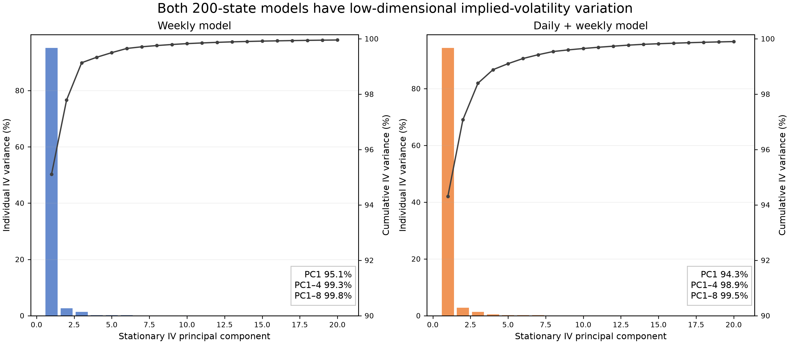
The 200-state dynamics map to a very low-dimensional IV manifold
REPLACES 24
These are PCA directions in decoded implied-volatility space under the fitted invariant state covariance—not the 200 affine state coordinates themselves.
Finite-difference Jacobian of the affine SANOS decoder at the invariant mean; factor size is one stationary standard deviation.

Slide 31
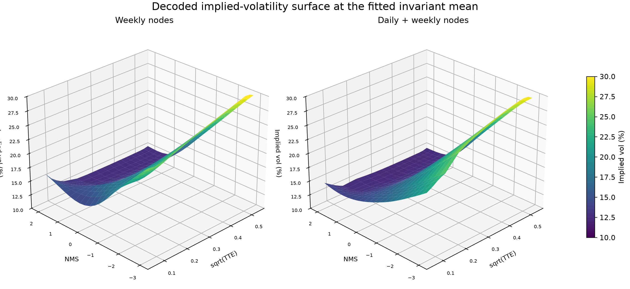
Invariant-mean/base implied-volatility surfaces for both models
REVIEW — NEW
Each surface is the affine SANOS decoder evaluated at the fitted AR(1) invariant mean b; axes are √TTE, NMS, and annualized implied volatility.

Slide 32
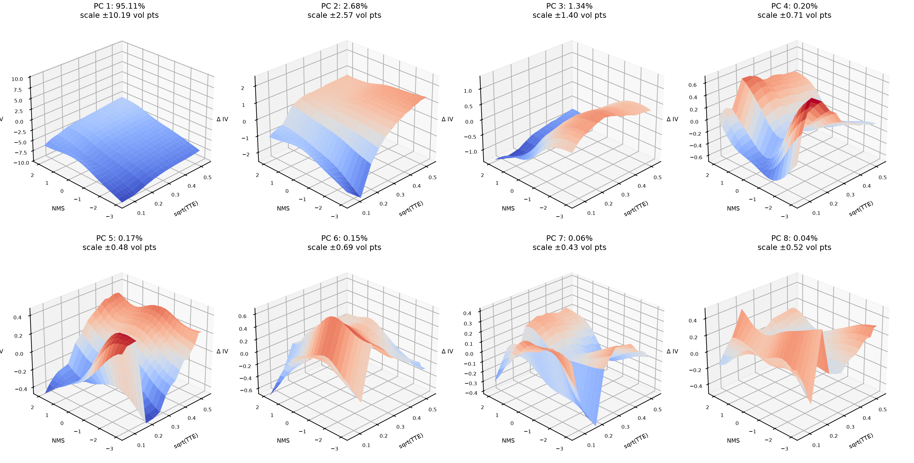
Weekly PCA factors: stationary IV PCs 1–8
REVIEW — NEW
Axes: √TTE, normalized moneyness (NMS), and implied-volatility change in vol points. Signs of PCA directions are arbitrary.

Slide 33
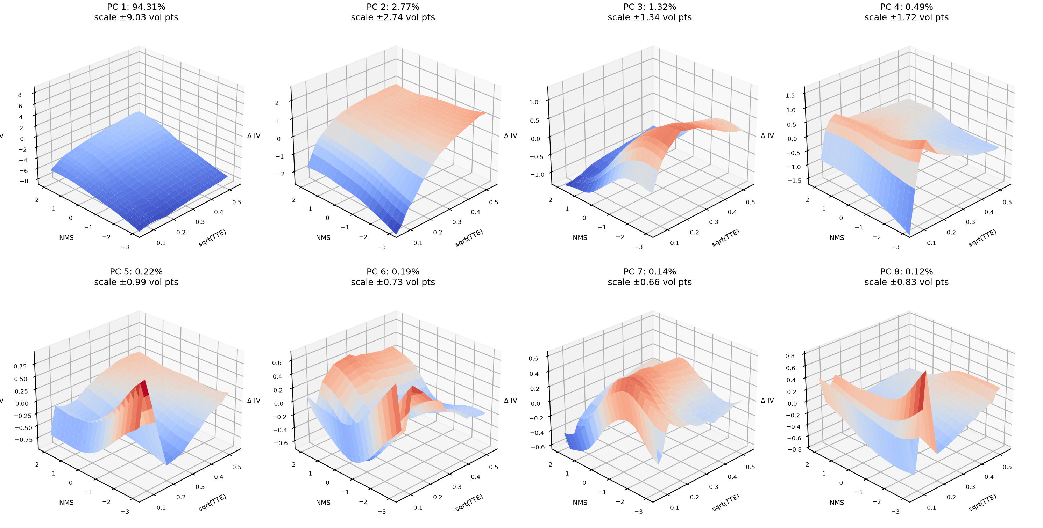
Daily + weekly PCA factors: stationary IV PCs 1–8
REVIEW — NEW
Axes: √TTE, normalized moneyness (NMS), and implied-volatility change in vol points. Signs of PCA directions are arbitrary.

Slide 34
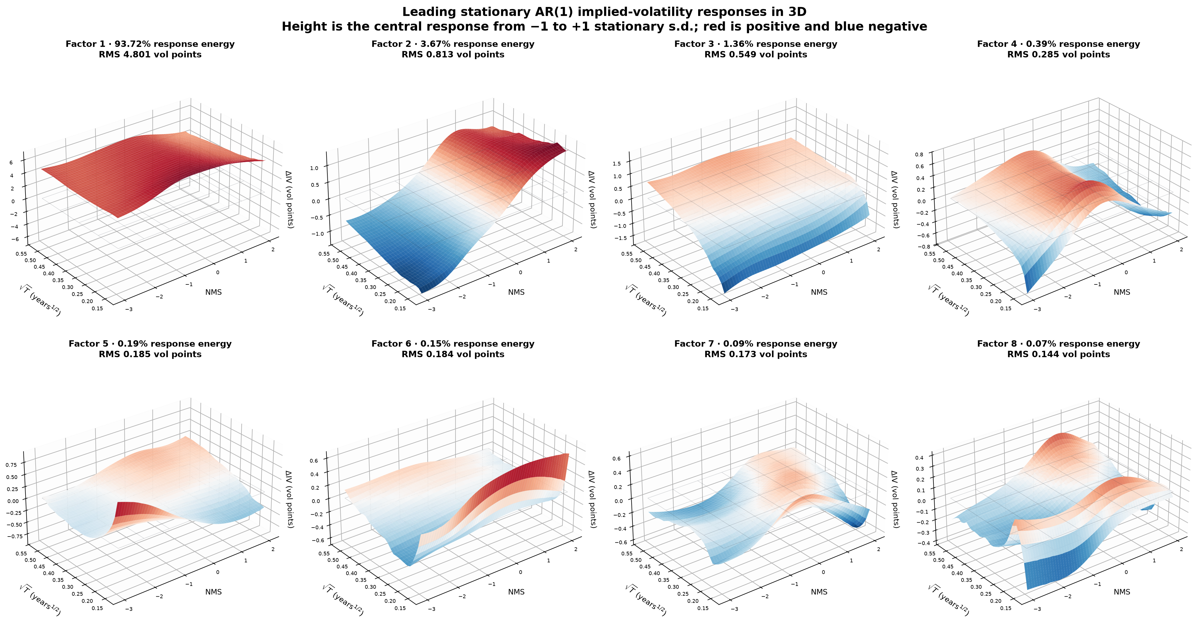
Linear Auto Regressive DYSANOS

Slide 35
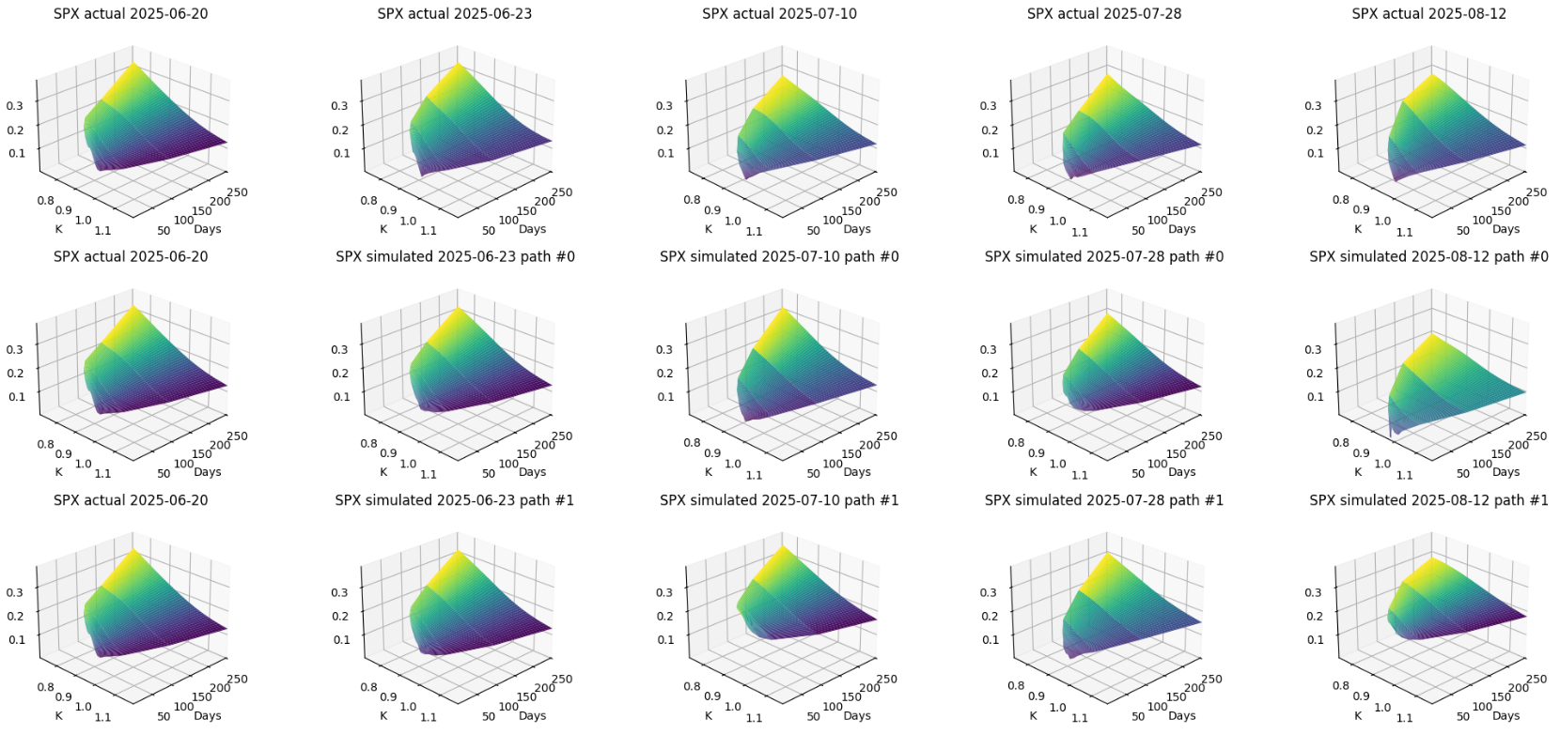
Generative SANOS
REVIEW: Hidden: replaced by invariant-distribution samples from both completed affine-200 models.
Vol simulated vs actual: top is actual, the other two sampled.
Eight business day steps between each shown surface
Actual
Simulated

Slide 36
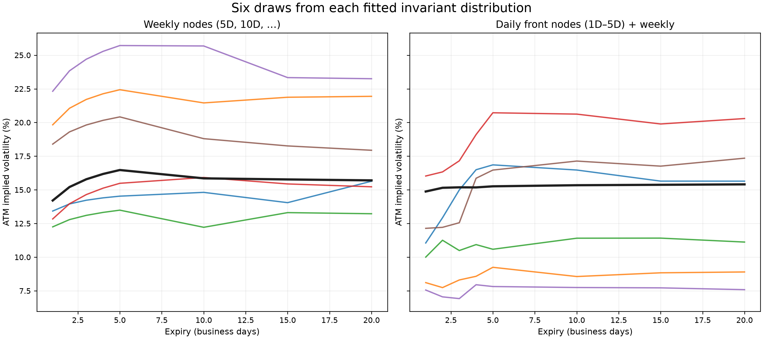
Invariant draws expose the weekly model's restricted short-end geometry
REPLACES 26
With no 1–4D nodes, every weekly-model short-end curve inherits extrapolation from 5D. The daily+weekly model can express observed front-end dislocations.
Six independent Gaussian draws from each fitted invariant N(b, Σ∞); black line is the invariant mean. These are static surfaces, not simulated time paths.

Slide 37
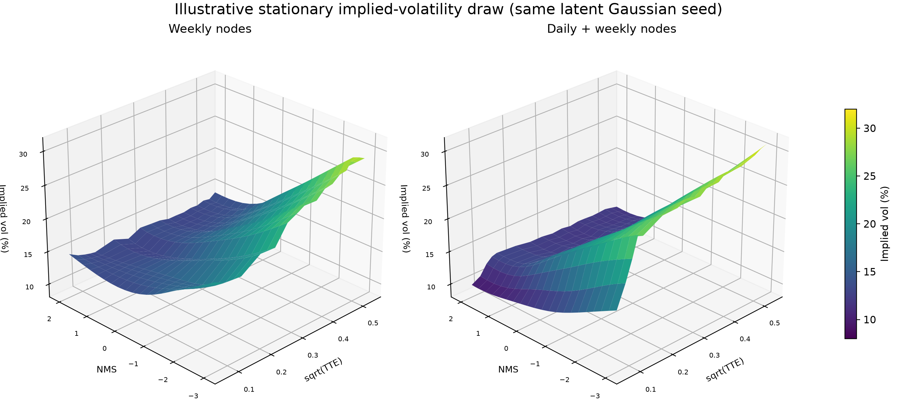
Gimmick: two complete stationary volatility-surface draws
REVIEW — NEW
Same 200-dimensional standard-normal seed, mapped through each model's own invariant covariance and affine SANOS decoder.

Slide 38
Dynamic Arbitrage

Slide 39
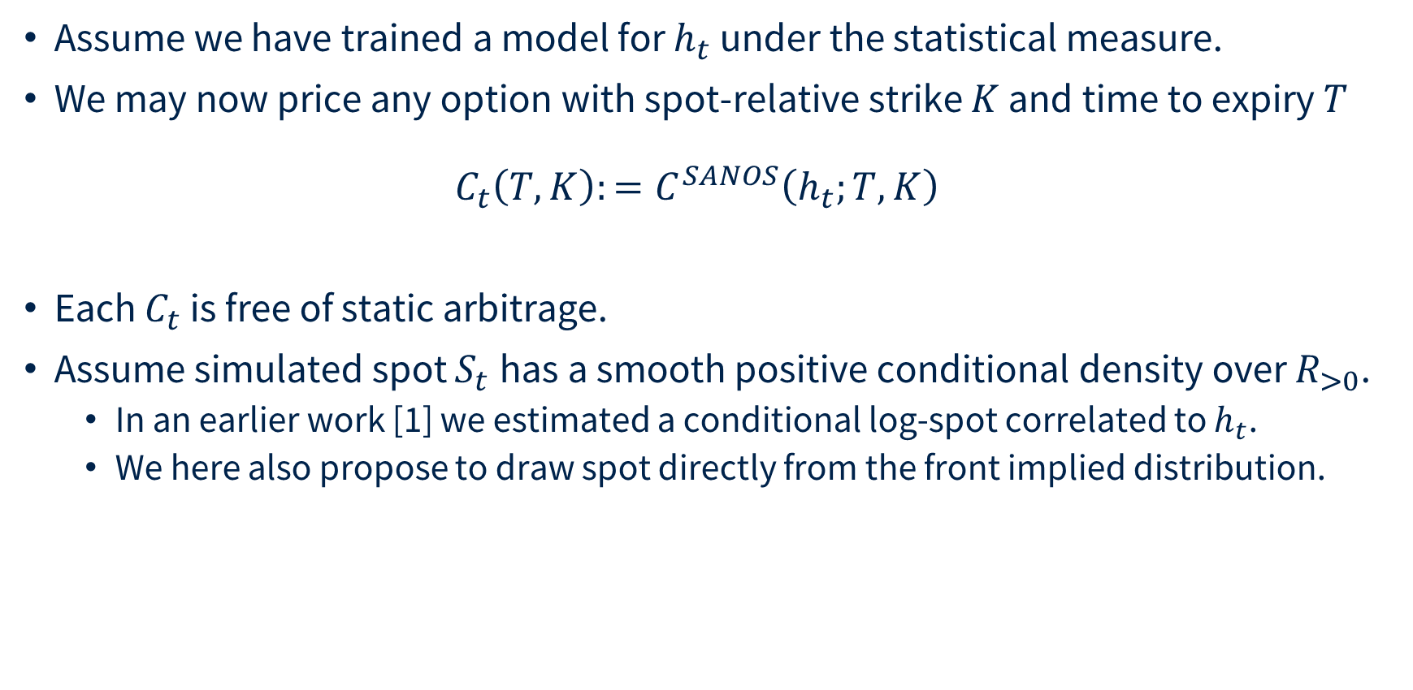
Dynamic Arbitrage
Assume we have trained a model for $h_{t}$ under the statistical measure.
We may now price any option with spot-relative strike $K$ and time to expiry $T$
$C_{t}\left(T,K\right):=C^{SANOS}\left(h_{t};T, K\right)$
Each $C_{t}$ is free of static arbitrage.
Assume simulated spot $S_{t}$has a smooth positive conditional density over $R_{>0}$.
  In an earlier work [1] we estimated a conditional log-spot correlated to $h_{t}$.
  We here also propose to draw spot directly from the front implied distribution.
__
[1] Hans Buehler et al. DYSANOS Generative Dynamic Smooth Arbitrage-free Non-parametric Option Surfaces, 2026 https://arxiv.org/abs/2608.12587

Slide 40
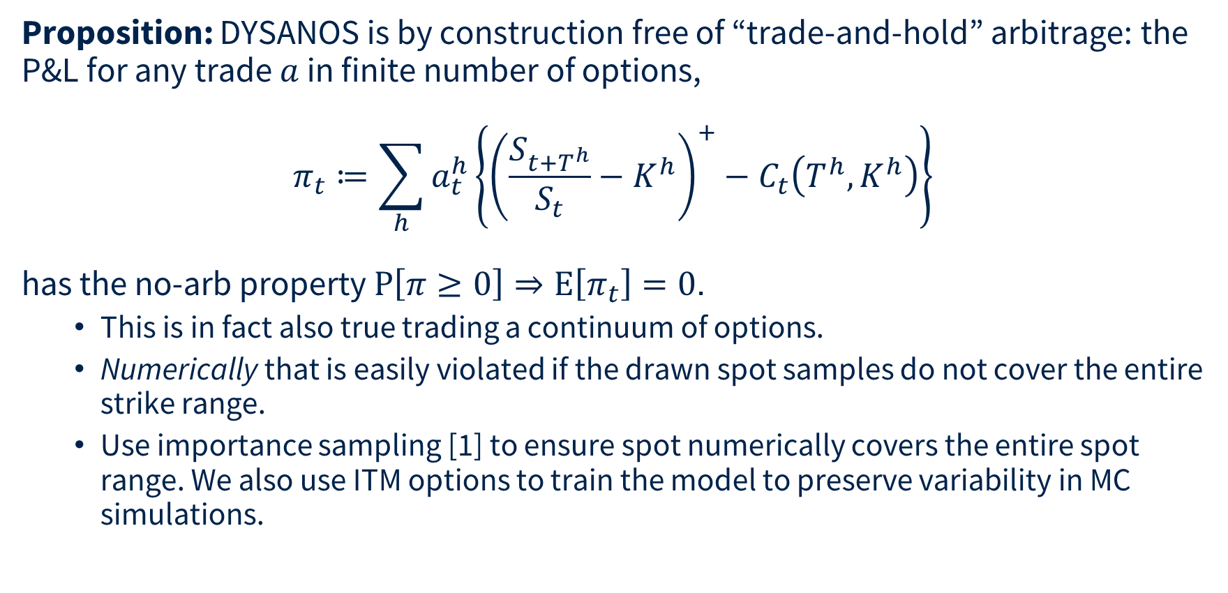
Dynamic Arbitrage
Proposition: DYSANOS is by construction free of “trade-and-hold” arbitrage: the P&L for any trade $a$ in finite number of options,
$$π_{t}≔\sum_{h}{a_{t}^{h}\left\{{\left(\frac{S_{t+T^{h}}}{S_{t}}−K^{h}\right)}^{+}−C_{t}\left(T^{h},K^{h}\right)\right\}}$$
has the no-arb property $P\left[π≥0\right]⇒E\left[π_{t}\right]=0$.
  This is in fact also true trading a continuum of options.
  Numerically that is easily violated if the drawn spot samples do not cover the entire strike range.
  Use importance sampling [1] to ensure spot numerically covers the entire spot range. We also use ITM options to train the model to preserve variability in MC simulations.
__
[1] Hans Buehler et al. DYSANOS Generative Dynamic Smooth Arbitrage-free Non-parametric Option Surfaces, 2026 https://arxiv.org/abs/2608.12587

Slide 41
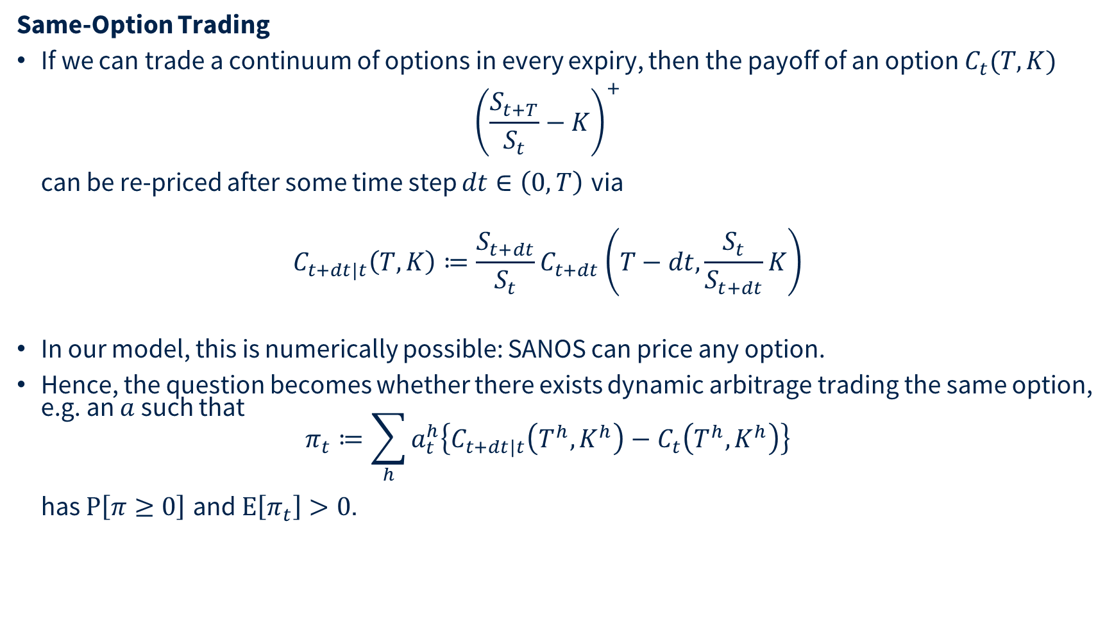
Dynamic Arbitrage
Same-Option Trading
If we can trade a continuum of options in every expiry, then the payoff of an option $C_{t}(T,K)$
${\left(\frac{S_{t+T}}{S_{t}}−K\right)}^{+}$
can be re-priced after some time step $dt∈\left(0,T\right)$ via
$C_{t+dt|t}\left(T,K\right)≔\frac{S_{t+dt}}{S_{t}}C_{t+dt}\left(T−dt,\frac{S_{t}}{S_{t+dt}}K\right)$
In our model, this is numerically possible: SANOS can price any option.
Hence, the question becomes whether there exists dynamic arbitrage trading the same option, e.g. an $a$ such that
$π_{t}≔\sum_{h}{a_{t}^{h}\left\{C_{t+dt|t}\left(T^{h},K^{h}\right)−C_{t}\left(T^{h},K^{h}\right)\right\}}$
has $P\left[π≥0\right]$ and $E\left[π_{t}\right]>0$.

Slide 42
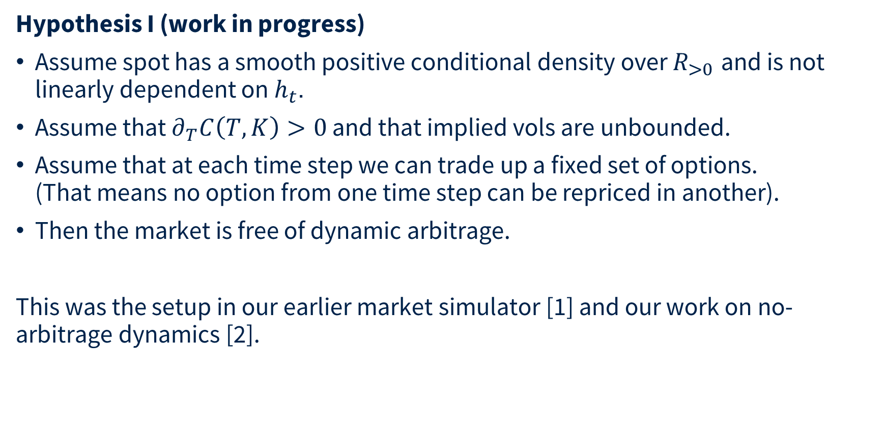
Dynamic Arbitrage
Hypothesis I (work in progress)
Assume spot has a smooth positive conditional density over $R_{>0}$ and is not linearly dependent on $h_{t}$.
Assume that $∂_{T}C\left(T,K\right)>0$ and that implied vols are unbounded.
Assume that at each time step we can trade up a fixed set of options.
(That means no option from one time step can be repriced in another).
Then the market is free of dynamic arbitrage.
This was the setup in our earlier market simulator [1] and our work on no-arbitrage dynamics [2].
__
[1] Multi-Asset Spot and Option Market Simulation, Wiese et al 2021 https://arxiv.org/abs/2112.06823
[2] Deep hedging: learning to remove the drift, Buehler et al 2022 https://www.risk.net/cutting-edge/banking/7932226/deep-hedging-learning-to-remove-the-drift and https://arxiv.org/abs/2111.07844

Slide 43
Dynamic Arbitrage
Hypothesis II (work in progress)
We can find a measure such that DYSANOS is fully dynamically arbitrage free for a pre-specified finite number of options.
Status
The challenge is that strict arbitrage is numerically very hard to distinguish from a very good trade. That means [1] fails numerically here.
Need a clean concept of numerical absence of arbitrage. It is sufficient if the conditional expectation is statistically indistinguishable from zero.
Incorporate this into a robust learning process.
__
[1] Deep hedging: learning to remove the drift, Buehler et al 2022 https://www.risk.net/cutting-edge/banking/7932226/deep-hedging-learning-to-remove-the-drift and https://arxiv.org/abs/2111.07844

Slide 44
Generative “DYSANOS” V1.1
REVIEW: Hidden: replacement summary incorporates the completed 2022–Aug 2025 experiments.
Summary
  Define a discrete, smoothed version of local vol.
  Express in real-valued coordinates.
  Encode it via some 200-dimensional candidate state.
  PCA with 8 factors → believable normal dynamics but misses heavy tails.
  Change measure → risk neutral.
What next
  Free instrument choice in Deep Hedging.
  Better dynamics than AR1 PCA.

Slide 45
What the expanded experiments establish
REPLACES 33
1
Expiry geometry
Weekly nodes fit the liquid range, but extrapolate poorly before 5D. Explicit 1–4D nodes fix the short end.
2
Compression
Affine compression to 200 states costs only 0.32 pp inside-spread for weekly and 1.83 pp for daily+weekly.
3
Dynamics
Both AR(1) transitions are stable (ρ < 0.96) with finite invariant covariance and ≈15–17 week slow-mode half-lives.
4
Innovation law
Gaussian innovations materially understate market tails. Historical residual replay is exact at 1W and closer at 2W/3W.
5
Simulation
Invariant draws are arbitrage-free through the SANOS decoder; the daily+weekly geometry produces richer front-end variation.
Separate workstream: the conditional-Q existence experiment remains paused with its checkpoints preserved.
Recommended narrative: market fit → compression → P-dynamics → innovation law → invariant samples → Q-existence as ongoing work.

Slide 46
Appendix — Weekly native: all per-expiry fit statistics
REVIEW — NEW
DTE | N (k) | Inside % | Cond. mean | Cond. med.
1 | 78.7 | 24.10 | 15.126 | 8.412
2 | 104.5 | 32.46 | 11.053 | 6.821
3 | 122.4 | 42.05 | 6.698 | 4.134
4 | 135.8 | 55.71 | 3.551 | 1.922
5 | 143.9 | 45.40 | 4.764 | 3.290
6 | 138.2 | 51.22 | 3.707 | 2.209
7 | 129.9 | 52.51 | 3.423 | 1.980
8 | 125.2 | 57.51 | 2.758 | 1.597
9 | 123.0 | 66.08 | 1.824 | 0.859
10 | 122.3 | 63.44 | 1.790 | 0.864
11 | 105.3 | 63.26 | 1.964 | 0.911
12 | 98.4 | 61.60 | 2.157 | 1.026
13 | 96.7 | 67.31 | 1.778 | 0.824
14 | 94.8 | 74.79 | 1.173 | 0.519
15 | 89.9 | 75.57 | 1.150 | 0.405
16 | 80.6 | 74.35 | 1.370 | 0.575
17 | 78.8 | 71.44 | 1.480 | 0.685
18 | 79.2 | 77.67 | 1.129 | 0.557
19 | 80.7 | 81.13 | 0.858 | 0.378
20 | 77.8 | 83.49 | 0.811 | 0.305
21 | 68.8 | 81.67 | 0.806 | 0.341
22 | 61.6 | 78.46 | 1.219 | 0.416
23 | 57.0 | 82.88 | 0.943 | 0.375
DTE | N (k) | Inside % | Cond. mean | Cond. med.
24 | 53.4 | 84.69 | 0.595 | 0.292
25 | 50.2 | 88.73 | 0.422 | 0.184
26 | 47.2 | 86.54 | 0.596 | 0.256
27 | 45.8 | 83.38 | 1.084 | 0.420
28 | 45.6 | 85.71 | 0.669 | 0.282
29 | 44.6 | 87.95 | 0.461 | 0.222
30 | 42.5 | 93.33 | 0.328 | 0.124
31 | 40.7 | 93.80 | 0.466 | 0.137
32 | 40.3 | 91.04 | 0.621 | 0.232
33 | 38.1 | 90.84 | 0.441 | 0.186
34 | 34.2 | 90.36 | 0.411 | 0.190
35 | 32.2 | 95.91 | 0.243 | 0.127
36 | 30.5 | 97.41 | 0.417 | 0.094
37 | 30.6 | 95.83 | 0.450 | 0.159
38 | 30.6 | 96.16 | 0.554 | 0.141
39 | 29.8 | 96.77 | 0.341 | 0.145
40 | 27.7 | 98.54 | 0.275 | 0.101
41 | 27.1 | 99.32 | 0.163 | 0.067
42 | 26.4 | 98.98 | 0.468 | 0.177
43 | 25.4 | 98.56 | 0.932 | 0.173
44 | 25.1 | 98.59 | 0.485 | 0.139
45 | 24.6 | 98.97 | 0.386 | 0.109
46 | 25.2 | 99.56 | 0.120 | 0.041
DTE | N (k) | Inside % | Cond. mean | Cond. med.
47 | 25.4 | 99.32 | 0.146 | 0.061
48 | 23.8 | 99.29 | 0.607 | 0.096
49 | 22.5 | 99.13 | 0.348 | 0.178
50 | 22.4 | 99.27 | 0.264 | 0.088
51 | 21.7 | 99.48 | 0.385 | 0.042
52 | 22.0 | 99.21 | 0.272 | 0.081
53 | 21.1 | 99.38 | 0.116 | 0.053
54 | 20.7 | 99.57 | 0.110 | 0.032
55 | 19.8 | 99.56 | 0.074 | 0.018
56 | 20.6 | 99.50 | 0.171 | 0.030
57 | 20.6 | 99.51 | 0.181 | 0.041
58 | 20.3 | 99.56 | 0.174 | 0.020
59 | 21.2 | 99.58 | 0.078 | 0.019
60 | 19.6 | 99.60 | 0.075 | 0.027
61 | 19.5 | 99.65 | 0.124 | 0.027
62 | 19.1 | 99.51 | 0.495 | 0.021
63 | 19.2 | 99.61 | 0.072 | 0.016
64 | 17.3 | 99.60 | 0.057 | 0.035
65 | 16.3 | 99.49 | 0.224 | 0.031
66 | 16.9 | 99.52 | 0.194 | 0.030
67 | 15.9 | 99.53 | 0.104 | 0.040
68 | 15.1 | 99.54 | 0.191 | 0.019
69 | 14.2 | 99.39 | 0.213 | 0.034
Native SANOS geometry with expiry nodes 5D, 10D, …, 70D.
Every nominal market-expiry bucket from 1D through 69D. Conditional statistics are computed only for quotes outside bid–ask; complete-precision values remain in the source report.

Slide 47
Appendix — Weekly affine-200: all per-expiry fit statistics
REVIEW — NEW
DTE | N (k) | Inside % | Cond. mean | Cond. med.
1 | 78.7 | 24.42 | 14.836 | 8.163
2 | 104.5 | 32.65 | 10.860 | 6.692
3 | 122.4 | 42.20 | 6.579 | 4.043
4 | 135.8 | 55.02 | 3.540 | 1.958
5 | 143.9 | 45.27 | 4.732 | 3.263
6 | 138.2 | 51.10 | 3.714 | 2.195
7 | 129.9 | 52.51 | 3.438 | 1.995
8 | 125.2 | 57.33 | 2.758 | 1.601
9 | 123.0 | 65.56 | 1.820 | 0.871
10 | 122.3 | 63.07 | 1.800 | 0.890
11 | 105.3 | 63.12 | 1.967 | 0.926
12 | 98.4 | 61.29 | 2.156 | 1.032
13 | 96.7 | 66.79 | 1.780 | 0.824
14 | 94.8 | 74.07 | 1.176 | 0.556
15 | 89.9 | 75.30 | 1.160 | 0.445
16 | 80.6 | 74.31 | 1.370 | 0.592
17 | 78.8 | 71.18 | 1.471 | 0.697
18 | 79.2 | 77.00 | 1.127 | 0.569
19 | 80.7 | 80.58 | 0.855 | 0.403
20 | 77.8 | 83.13 | 0.810 | 0.329
21 | 68.8 | 81.41 | 0.806 | 0.366
22 | 61.6 | 77.80 | 1.209 | 0.433
23 | 57.0 | 82.33 | 0.936 | 0.388
DTE | N (k) | Inside % | Cond. mean | Cond. med.
24 | 53.4 | 84.29 | 0.599 | 0.300
25 | 50.2 | 88.40 | 0.424 | 0.195
26 | 47.2 | 86.44 | 0.593 | 0.278
27 | 45.8 | 82.57 | 1.038 | 0.400
28 | 45.6 | 84.92 | 0.660 | 0.290
29 | 44.6 | 87.48 | 0.467 | 0.235
30 | 42.5 | 92.61 | 0.334 | 0.133
31 | 40.7 | 93.02 | 0.444 | 0.157
32 | 40.3 | 90.21 | 0.602 | 0.241
33 | 38.1 | 90.13 | 0.427 | 0.188
34 | 34.2 | 89.49 | 0.400 | 0.200
35 | 32.2 | 95.19 | 0.251 | 0.135
36 | 30.5 | 96.70 | 0.390 | 0.116
37 | 30.6 | 95.34 | 0.433 | 0.157
38 | 30.6 | 95.77 | 0.552 | 0.158
39 | 29.8 | 96.14 | 0.308 | 0.145
40 | 27.7 | 98.25 | 0.272 | 0.115
41 | 27.1 | 99.02 | 0.173 | 0.089
42 | 26.4 | 98.65 | 0.398 | 0.178
43 | 25.4 | 98.15 | 0.770 | 0.149
44 | 25.1 | 98.13 | 0.400 | 0.121
45 | 24.6 | 98.77 | 0.388 | 0.105
46 | 25.2 | 99.41 | 0.131 | 0.064
DTE | N (k) | Inside % | Cond. mean | Cond. med.
47 | 25.4 | 99.01 | 0.134 | 0.066
48 | 23.8 | 98.96 | 0.446 | 0.097
49 | 22.5 | 98.83 | 0.304 | 0.147
50 | 22.4 | 99.05 | 0.300 | 0.092
51 | 21.7 | 99.39 | 0.436 | 0.104
52 | 22.0 | 98.92 | 0.272 | 0.088
53 | 21.1 | 99.14 | 0.128 | 0.057
54 | 20.7 | 99.35 | 0.151 | 0.072
55 | 19.8 | 99.52 | 0.113 | 0.051
56 | 20.6 | 99.30 | 0.210 | 0.069
57 | 20.6 | 99.31 | 0.146 | 0.048
58 | 20.3 | 99.40 | 0.171 | 0.048
59 | 21.2 | 99.46 | 0.109 | 0.050
60 | 19.6 | 99.57 | 0.091 | 0.063
61 | 19.5 | 99.49 | 0.104 | 0.035
62 | 19.1 | 99.43 | 0.129 | 0.036
63 | 19.2 | 99.45 | 0.089 | 0.034
64 | 17.3 | 99.45 | 0.084 | 0.055
65 | 16.3 | 99.50 | 0.106 | 0.027
66 | 16.9 | 99.59 | 0.088 | 0.025
67 | 15.9 | 99.59 | 0.069 | 0.024
68 | 15.1 | 99.52 | 0.259 | 0.042
69 | 14.2 | 99.49 | 0.321 | 0.058
The same weekly SANOS geometry after affine compression to a 200-dimensional state.
Every nominal market-expiry bucket from 1D through 69D. Conditional statistics are computed only for quotes outside bid–ask; complete-precision values remain in the source report.

Slide 48
Appendix — Daily + weekly native: all per-expiry fit statistics
REVIEW — NEW
DTE | N (k) | Inside % | Cond. mean | Cond. med.
1 | 78.6 | 93.55 | 3.565 | 1.328
2 | 104.4 | 94.45 | 2.501 | 1.247
3 | 122.3 | 94.94 | 1.754 | 0.894
4 | 135.7 | 95.29 | 1.392 | 0.674
5 | 143.9 | 68.41 | 3.113 | 0.819
6 | 138.2 | 66.88 | 1.920 | 1.033
7 | 129.9 | 57.60 | 2.649 | 1.475
8 | 125.2 | 59.79 | 2.507 | 1.391
9 | 123.0 | 67.00 | 1.789 | 0.800
10 | 122.3 | 65.31 | 1.515 | 0.739
11 | 105.3 | 65.00 | 1.845 | 0.826
12 | 98.4 | 62.56 | 2.126 | 0.965
13 | 96.7 | 68.04 | 1.780 | 0.809
14 | 94.8 | 75.14 | 1.170 | 0.525
15 | 89.9 | 76.16 | 1.155 | 0.404
16 | 80.6 | 75.11 | 1.412 | 0.604
17 | 78.8 | 71.88 | 1.495 | 0.715
18 | 79.2 | 77.80 | 1.126 | 0.555
19 | 80.7 | 81.12 | 0.860 | 0.383
20 | 77.8 | 83.46 | 0.821 | 0.311
21 | 68.8 | 81.77 | 0.821 | 0.357
22 | 61.6 | 78.38 | 1.214 | 0.431
23 | 57.0 | 82.81 | 0.960 | 0.391
DTE | N (k) | Inside % | Cond. mean | Cond. med.
24 | 53.4 | 84.68 | 0.613 | 0.302
25 | 50.2 | 88.62 | 0.448 | 0.206
26 | 47.2 | 86.37 | 0.617 | 0.258
27 | 45.8 | 83.01 | 1.098 | 0.421
28 | 45.6 | 85.40 | 0.690 | 0.300
29 | 44.6 | 87.69 | 0.468 | 0.231
30 | 42.5 | 93.11 | 0.348 | 0.138
31 | 40.7 | 93.40 | 0.473 | 0.142
32 | 40.3 | 90.30 | 0.598 | 0.235
33 | 38.1 | 90.30 | 0.452 | 0.199
34 | 34.2 | 89.92 | 0.412 | 0.209
35 | 32.2 | 95.46 | 0.277 | 0.133
36 | 30.5 | 96.83 | 0.418 | 0.109
37 | 30.6 | 95.17 | 0.437 | 0.158
38 | 30.6 | 95.77 | 0.551 | 0.152
39 | 29.8 | 96.22 | 0.340 | 0.150
40 | 27.7 | 98.10 | 0.240 | 0.113
41 | 27.1 | 98.80 | 0.202 | 0.083
42 | 26.4 | 98.40 | 0.420 | 0.137
43 | 25.4 | 97.97 | 0.767 | 0.158
44 | 25.1 | 97.49 | 0.421 | 0.136
45 | 24.6 | 98.27 | 0.508 | 0.123
46 | 25.2 | 98.97 | 0.367 | 0.085
DTE | N (k) | Inside % | Cond. mean | Cond. med.
47 | 25.4 | 98.66 | 0.298 | 0.127
48 | 23.8 | 98.67 | 0.560 | 0.122
49 | 22.6 | 98.35 | 0.337 | 0.155
50 | 22.4 | 98.94 | 0.317 | 0.104
51 | 21.7 | 98.98 | 0.412 | 0.096
52 | 22.0 | 98.74 | 0.366 | 0.154
53 | 21.1 | 98.74 | 0.196 | 0.069
54 | 20.7 | 98.76 | 0.218 | 0.074
55 | 19.8 | 98.87 | 0.302 | 0.084
56 | 20.6 | 99.09 | 0.215 | 0.071
57 | 20.6 | 99.11 | 0.266 | 0.071
58 | 20.3 | 99.04 | 0.297 | 0.058
59 | 21.2 | 99.09 | 0.362 | 0.089
60 | 19.6 | 99.14 | 0.306 | 0.058
61 | 19.5 | 99.20 | 0.273 | 0.059
62 | 19.1 | 99.20 | 0.612 | 0.089
63 | 19.2 | 99.09 | 0.206 | 0.056
64 | 17.3 | 98.86 | 0.562 | 0.086
65 | 16.3 | 99.08 | 0.617 | 0.133
66 | 16.8 | 99.14 | 0.564 | 0.096
67 | 15.9 | 99.02 | 0.758 | 0.077
68 | 15.1 | 98.95 | 0.511 | 0.090
69 | 14.2 | 98.92 | 0.458 | 0.092
Native SANOS geometry with nodes 1D, 2D, 3D, 4D, 5D, 10D, …, 70D.
Every nominal market-expiry bucket from 1D through 69D. Conditional statistics are computed only for quotes outside bid–ask; complete-precision values remain in the source report.

Slide 49
Appendix — Daily + weekly affine-200: all per-expiry fit statistics
REVIEW — NEW
DTE | N (k) | Inside % | Cond. mean | Cond. med.
1 | 78.6 | 84.64 | 1.886 | 0.528
2 | 104.4 | 89.59 | 1.553 | 0.459
3 | 122.3 | 91.93 | 1.246 | 0.444
4 | 135.7 | 92.61 | 1.034 | 0.431
5 | 143.9 | 67.21 | 3.097 | 0.937
6 | 138.2 | 66.30 | 1.910 | 1.035
7 | 129.9 | 57.47 | 2.661 | 1.479
8 | 125.2 | 58.96 | 2.523 | 1.396
9 | 123.0 | 65.82 | 1.831 | 0.853
10 | 122.3 | 64.43 | 1.552 | 0.820
11 | 105.3 | 64.36 | 1.839 | 0.856
12 | 98.4 | 61.71 | 2.125 | 1.012
13 | 96.7 | 66.66 | 1.782 | 0.847
14 | 94.8 | 73.69 | 1.183 | 0.581
15 | 89.9 | 74.70 | 1.165 | 0.484
16 | 80.6 | 73.91 | 1.379 | 0.628
17 | 78.8 | 70.77 | 1.476 | 0.738
18 | 79.2 | 75.86 | 1.133 | 0.605
19 | 80.7 | 79.13 | 0.866 | 0.429
20 | 77.8 | 81.18 | 0.836 | 0.382
21 | 68.8 | 79.70 | 0.833 | 0.443
22 | 61.6 | 76.45 | 1.203 | 0.503
23 | 57.0 | 80.62 | 0.944 | 0.432
DTE | N (k) | Inside % | Cond. mean | Cond. med.
24 | 53.4 | 82.21 | 0.624 | 0.339
25 | 50.2 | 85.68 | 0.496 | 0.253
26 | 47.2 | 84.26 | 0.620 | 0.312
27 | 45.8 | 80.70 | 1.035 | 0.424
28 | 45.6 | 82.34 | 0.657 | 0.339
29 | 44.6 | 84.88 | 0.474 | 0.262
30 | 42.5 | 89.75 | 0.393 | 0.194
31 | 40.7 | 90.63 | 0.514 | 0.233
32 | 40.3 | 87.35 | 0.599 | 0.273
33 | 38.1 | 87.37 | 0.465 | 0.249
34 | 34.2 | 86.45 | 0.437 | 0.239
35 | 32.2 | 92.74 | 0.292 | 0.168
36 | 30.5 | 94.47 | 0.397 | 0.169
37 | 30.6 | 92.45 | 0.414 | 0.215
38 | 30.6 | 93.05 | 0.443 | 0.163
39 | 29.8 | 93.51 | 0.317 | 0.169
40 | 27.7 | 96.47 | 0.263 | 0.147
41 | 27.1 | 97.17 | 0.247 | 0.140
42 | 26.4 | 96.34 | 0.317 | 0.160
43 | 25.4 | 96.18 | 0.582 | 0.215
44 | 25.1 | 95.95 | 0.394 | 0.166
45 | 24.6 | 97.15 | 0.519 | 0.140
46 | 25.2 | 97.68 | 0.382 | 0.150
DTE | N (k) | Inside % | Cond. mean | Cond. med.
47 | 25.4 | 97.68 | 0.353 | 0.145
48 | 23.8 | 97.45 | 0.480 | 0.140
49 | 22.6 | 97.36 | 0.369 | 0.167
50 | 22.4 | 98.11 | 0.419 | 0.145
51 | 21.7 | 98.02 | 0.436 | 0.168
52 | 22.0 | 97.59 | 0.317 | 0.152
53 | 21.1 | 97.78 | 0.225 | 0.112
54 | 20.7 | 97.73 | 0.277 | 0.121
55 | 19.8 | 98.40 | 0.513 | 0.141
56 | 20.6 | 98.46 | 0.307 | 0.117
57 | 20.6 | 98.60 | 0.243 | 0.088
58 | 20.3 | 98.34 | 0.255 | 0.126
59 | 21.2 | 98.52 | 0.336 | 0.121
60 | 19.6 | 98.72 | 0.230 | 0.083
61 | 19.5 | 98.69 | 0.205 | 0.090
62 | 19.1 | 98.74 | 0.424 | 0.095
63 | 19.2 | 98.68 | 0.184 | 0.078
64 | 17.3 | 98.53 | 0.540 | 0.110
65 | 16.3 | 98.87 | 0.584 | 0.103
66 | 16.8 | 98.75 | 0.576 | 0.106
67 | 15.9 | 98.95 | 0.697 | 0.100
68 | 15.1 | 99.08 | 0.323 | 0.091
69 | 14.2 | 99.02 | 0.599 | 0.089
The daily-front/weekly-tail SANOS geometry after affine compression to a 200-dimensional state.
Every nominal market-expiry bucket from 1D through 69D. Conditional statistics are computed only for quotes outside bid–ask; complete-precision values remain in the source report.

Slide 50
Please ask questions
hans.buehler@maths.ox.ac.uk

